Slide 1
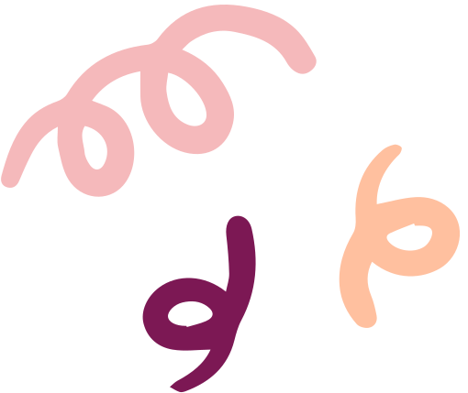
Syphilis is on the move!
The development and implementation of a state-wide gap analysis tool

Slide 2
Kaya, Wayiba, Wanthiwa
SHQ acknowledges Aboriginal and Torres Strait Islander peoples as the Traditional Custodians of Country throughout Australia and the continuing connection to lands, waters and communities.
In particular, we acknowledge the Whadjuk people of the Noongar Nation who are the traditional custodians of the land where SHQ is based.
We pay our respect to them, their culture, and to their Elders both past and present.

Slide 3
Project overview
SHQ received funding for 12 months from the Department of Health as part of a comprehensive state-wide response to help improve syphilis testing rates, treatment uptake and the reduction of syphilis cases in Western Australia. It takes place in the context of a syphilis outbreak in Western Australia and an increasing occurrence of congenital syphilis.
How?
Conduct a gap analysis on syphilis knowledge among clinical and community workers across Western Australia
2. Develop resources and education opportunities to fill identified gaps

Slide 4
Project overview
SHQ received funding for 12 months from the Department of Health as part of a comprehensive state-wide response to help improve syphilis testing rates, treatment uptake and the reduction of syphilis cases in Western Australia. It takes place in the context of a syphilis outbreak in Western Australia and an increasing occurrence of congenital syphilis.
How?
Conduct a gap analysis on syphilis knowledge among clinical and community workers across Western Australia
2. Develop resources and education opportunities to fill identified gaps

Slide 5
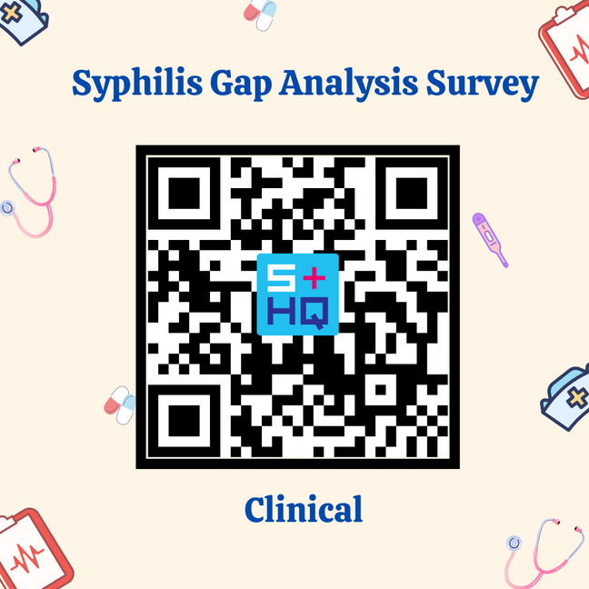
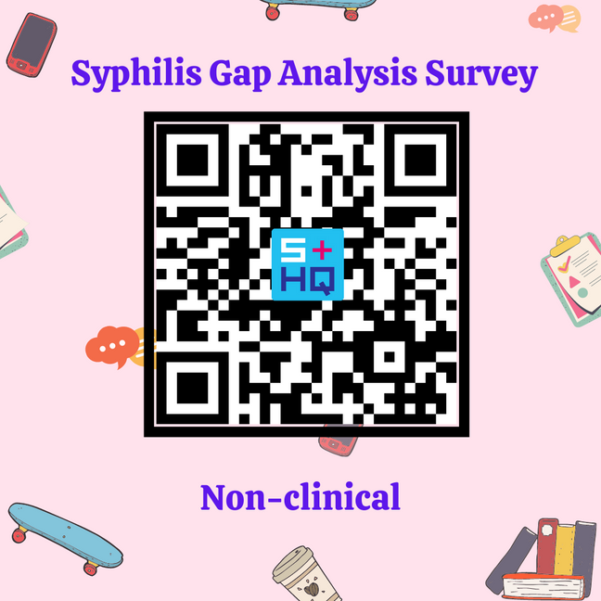
Gap Analysis Tool
SHQ developed and implemented a 40-item syphilis Gap Analysis Tool (GAT) in mid-late 2021.
Initially piloted in October 2021 with 25 purposively sampled participants for two weeks (metropolitan and Pilbara)
Final GAT sent out in late October 2021 for two weeks:
Directly emailed to 405 contacts
QR codes on social media tiles (SHQ e-news, social media, SHQ training courses)

Slide 6
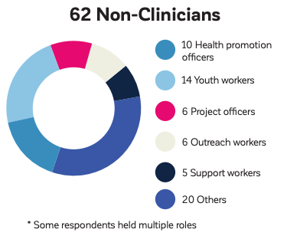
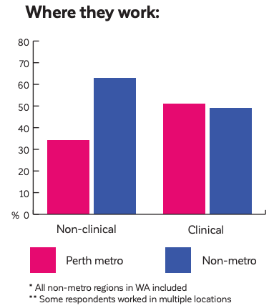
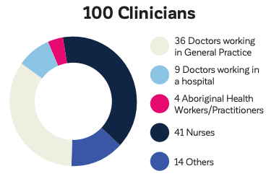
Who completed it?
76% completion rate
82% completion rate
51%
49%

Slide 7
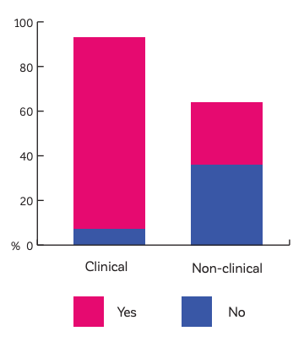
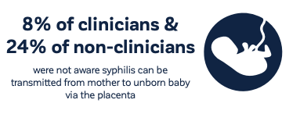
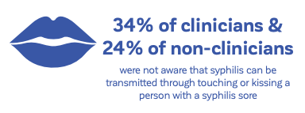
Results
Awareness of the outbreak varied between clinicians and non-clinicians
Syphilis knowledge gap evidenced in both groups
Differences between clinicians and non-clinicians in preferences for educational resources and professional development

Slide 8
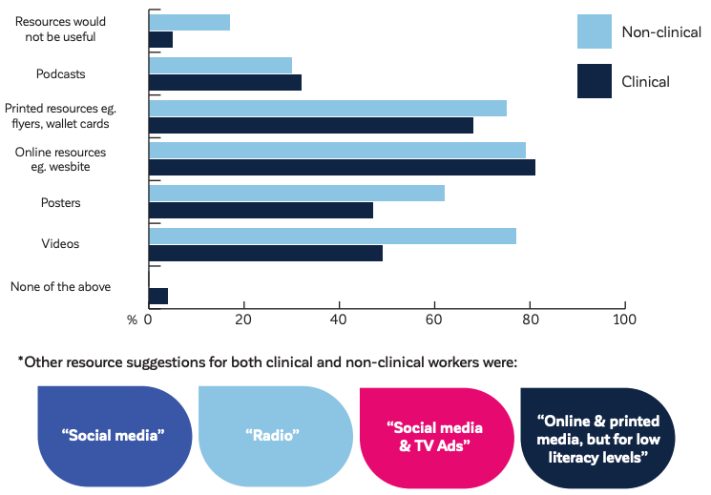
What now?
Results guiding development of a range of educational resources and professional development opportunities for both groups:
Education sessions for community workers
Social media campaign
Social marketing campaign
Video for community workers
Antenatal syphilis screening guidelines resource for clinicians

Slide 9
Thank you!
For a copy of the full results infographic:
rachael.laing@shq.org.au

