Slide 1
Peer
Harm Reduction
Education
∞
Valuing that which
we cannot measure
Peta Gava

Slide 2
Peer Based Harm Reduction WA
Providing services to people who inject drugs in WA for 24 years.
Harm reduction and clinical services to reduce the prevalence of BBV and STIs.
Nurse Practitioner operated health clinics in Perth and Bunbury
Mobile clinic vans in Perth & South West region
Peer HCV Case Management workers in Perth & South West
Fixed site NSEP in Perth & Bunbury
Home delivery NSEP in Perth & South West region
Postal NSEP anywhere in WA
Mobile NSEP van servicing the South West region
Community & workforce development
Health promotion & resource production
Peer Naloxone program
Peer education programs
Harm reduction information, education and advocacy with a significant emphasis on reducing stigma and discrimination.

Slide 3
Hep C PHRE project:
Why
How
Measurable Results
Immeasurable Value

Slide 4
The Hep C PHRE Project
Initiated through a grant from WA Department of Health in late 2018 and then supported for a further two years with funding through the Eliminate Hepatitis C Australia Partnership (Burnett Institute and Paul Ramsay Foundation).
Direct-acting antiviral treatments widely available but uptake was low amongst people who choose to inject drugs.
Effective services but many peers not engaged with our service – or any service at all.
Stigma and previous experiences of discrimination, often from health professionals, a known barrier.
Utilise the peer to peer credibility within peer networks to make information about hep C transmission, testing, treatment and services go viral.

Slide 5
What did we do?
DIARIES SUBMITTED MONTHLY. REMUNERATION & MENTORING PROVIDED.
HCV PEER WORKER FOLLOWED UP PEER REFERRALS FOR TESTING & TREATMENT
INTERACTIONS AND PEER REFERRALS RECORDED IN PEER DIARIES
RECRUITED AND TRAINED PEER EDUCATORS

Slide 6
Results 2019 to 2021
34
Peer Educators
158
Peer Referrals
65
Appointments
Testing/Treatment
877
Peers Reached

Slide 7
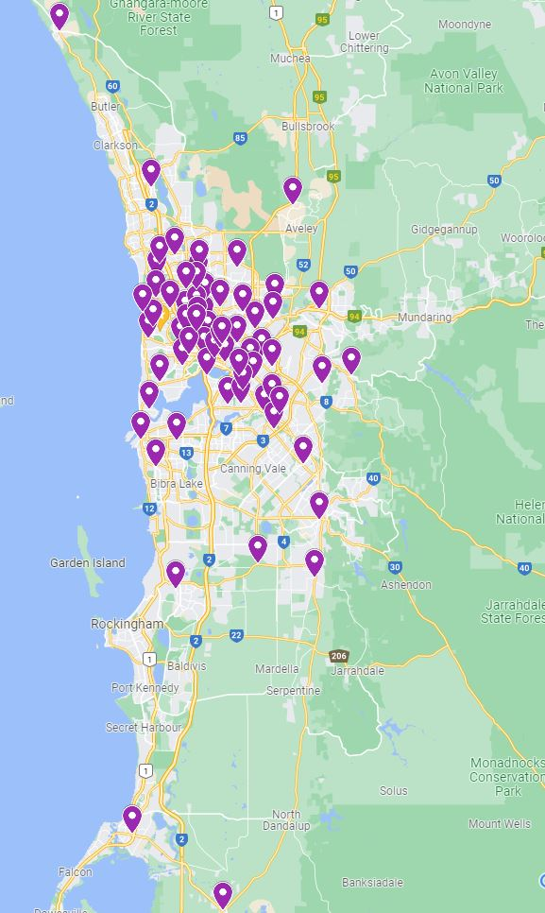
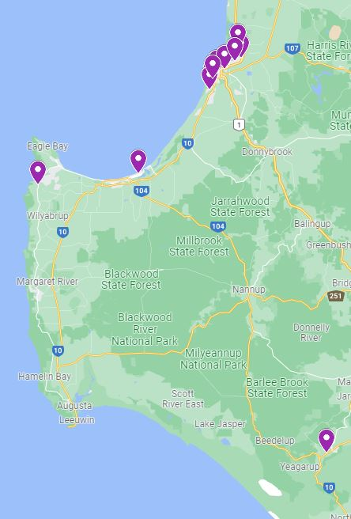
Reaching peers across more than 83 suburbs in Perth Metro area & South West (18 month period)

Slide 8
What did peer educators
talk about the most?
83% (739 out of 877) found interaction helpful

Slide 9
What was stopping people?
Their previous experiences of stigma in healthcare settings
The types of services available
Their concerns about privacy
No transport
Being homeless
The shame they felt
Sometimes, drug use is a full-time job
Not having symptoms
A lack of appropriateinformation
Their lack of confidence

Slide 10
Immeasurable learning…
“Wouldn’t have heard the information any other way”
“Rarely have contact with anyone other than users”
“Wouldn’t have spoken to a doctor due to privacy concerns”
“Peers are knowledgeable. The information is more appropriate for me”
“Doctors are always in a hurry and it’s hard to remember the questions I wanted to ask”
“I already feel stigmatised by the system. It felt easier to talk to a peer without fear of judgement”
“Easier to trust the information from someone who has been there”
“Knowing that my friends have sorted out their hep C made me think twice”

Slide 11
We must keep peer to peer conversations
about hep C alive.
Eliminating hep C is about more than clinic appointments.

Slide 12
Contact Us
P: 9325 8387
www.harmreductionwa.org
E: Hepc.phre@harmreductionwa.org

