Slide 1
TAKING IT TO THE STREETS:
Genuine Peer Involvement Increases
Access to HCV Testing and Uptake of HCV Treatments
Paul Jeffery
Hepatitis C Case Management (Perth)
Jodie Savage
Hepatitis C Case Management (Bunbury and Southwest)

Slide 2
We would like to acknowledge the traditional custodians of the land on which we meet, the Noongar People, and pay our respects to them, their culture, and to their Elders, past and present.

Slide 3
Presentation Overview
Who we are and what we do
Our Model of Care and ongoing evolution of the service
Hepatitis C Peer Case Management Worker roles
Hepatitis C Case Management Service; Perth and South West statistics
Why our model works, barriers to treatment and how we address them
Conclusion
Questions

Slide 4
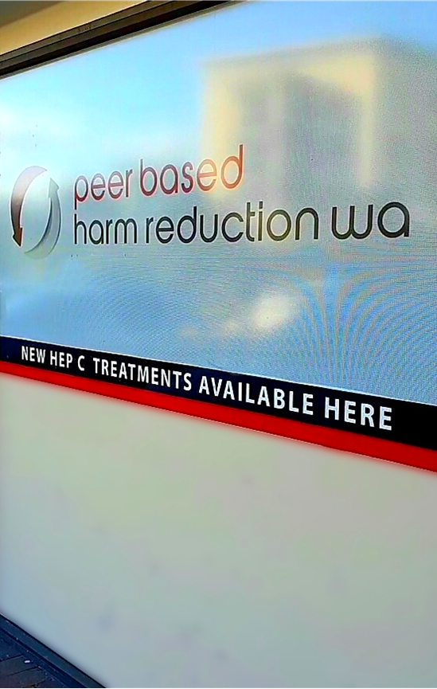
Peer Based Harm Reduction WA
Non-judgmental, friendly, peer based support, including information and education, advocacy, and health and harm reduction services aimed at reducing the transmission of Blood Borne Viruses and Sexually Transmitted Infections associated with drug use amongst the community in WA.
Notes:
Non-judgmental, friendly, peer based support, including information and education, advocacy, and health and harm reduction services aimed at reducing the transmission of Blood Borne Viruses and Sexually Transmitted Infections associated with drug use amongst the community in WA.
The only peer based, not-for-profit, community based harm reduction organisation that represents the needs and concerns of people who use or have used drugs in WA.
Our aim is to bring drug users’ perspectives into all our harm reduction initiatives as well as to our partnerships with other organisations and to our advice and advocacy to governments.
As a ‘peer based’ organisation, we are run by and for people who use or have used drugs and we support consumer participation at all levels of the organisation.

Slide 5
Who we are and what we do
2 fixed-site NSEPs located in Perth and Bunbury
Outreach and home-delivery NSEP services in
Perth Metro area and South West region
Postal Service (statewide)
South West Mobile NSEP van
Overdose Prevention and Management with Peer-Administered Naloxone program
Training and Education for broader AOD, Health, Mental Health, Community Welfare and Other Services
Health Clinics collocated at both fixed-sites & Mobile Health Clinic Vans available across the Perth Metro area and South West region provide free testing and treatment for BBVs & STIs as well as general health care
Rapid PCR testing for Hepatitis C and Point-of-Care testing for Syphilis
Hepatitis C Support from HCV Peer Case Management Workers

Slide 6
What we did in response to WHO elimination targets, listening to our consumers and reducing barriers
Identified tasks that could be performed by peer workers
Further expansion
Incentivised testing
HCV Peer Case Management Workers
Expanded accessibility – MNSEP, outreach, providing transport etc
Educated peer workers about HCV testing and treatments – brief interventions
Utilised existing social networks of consumers to provide hep C peer education project– HepCPHRE
Phlebotomy & HCV VL finger prick test training for staff
Notes:
In response to the World Health Organisation elimination targets, ongoing consultation with our consumers and measures to address a range of concerns and barriers which were identified by people who inject drugs our collaborative peer model has evolved since 2017.
Initially, we identified tasks that could be performed by peer workers who were at the frontline of our service.
Peer workers received HCV education and undertook phlebotomy training, enabling them to discuss HCV treatment options, address any consumer concerns, and to perform the required blood tests and finger prick testing.
Five peer workers have been trained to perform HCV RNA testing using the Cepheid GeneXPert module instrument.
To access populations who are not engaged with health services, we incentivised testing, expanded the health clinic through the mobile needle and syringe exchange program and outreach services visiting people in their homes.
To educate peers about hepatitis C we utilised the existing social networks of our consumers to provide hep c education.
Based on ongoing needs of patients in treatment preparation, during treatment and follow up
Consumer feedback addressing barriers informed the evolution of the role
HCV Case Management Worker role commenced in 2017 (Perth)
Expanded clinic model to include outreach “to the home” commencing in Perth metro area during November 2017
Expanded clinic to South West fixed-site in October 2018, including a South West HCV Peer Case Management Worker based in Bunbury
Hep C PHRE (Hep C Peer Harm Reduction Education) Peer Education Project established Dec 2018, and in South West shortly thereafter

Slide 7
HCV Case Management Service
Transport
Medication delivery
Coordinates outreach visits
General Support
Weekly phone contact
SVR reminders
HCV Peer Case Management Workers support PBHRWA consumers through their HCV treatment journey, and provide assistance to the Nurse Practitioner to ensure holistic throughcare for an improved consumer healthcare experience.
Includes appointment reminders, general support, and weekly contact to discuss treatment wellbeing, (such as medication compliance, side effects and/or other related issues).
Notes:
WE have two hepatitis C case management workers – 1 in Perth and 1 in Bunbury. who support people to engage in HCV testing and treatment and then follow the patient through the treatment process by providing weekly phone calls, medication delivery, and transport to other appointments.
The HCV case management worker also coordinates outreach visits which we conduct fortnightly.
96 out of 108 people have been supported during the treatment process by the HCV cases management worker. The HCV case management worker completes and records visits and phone calls for inclusion either in the patient notes or for the required outcome reporting.

Slide 8
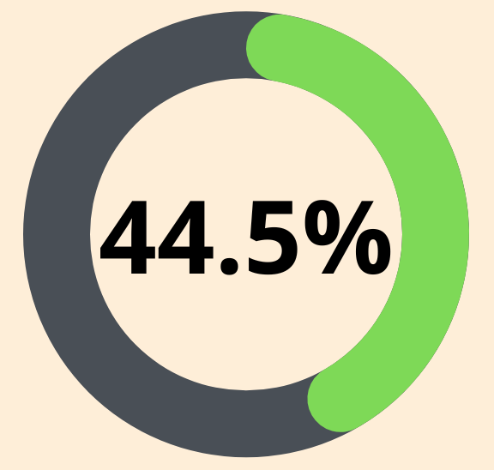
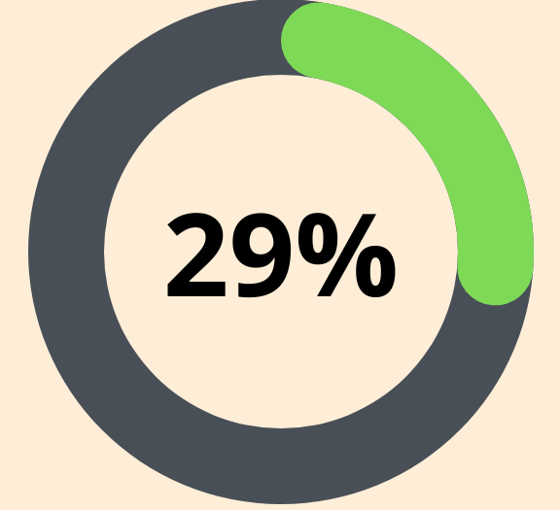
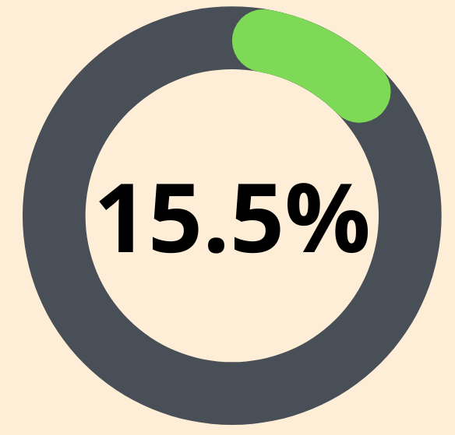
HCV Case Management Service Perth Statistics
469
208 Consumers tested HCV RNA + (including 13 x re-infected)
Total consumers on database
60 consumers completed treatment and achieved SVR (including 2 x re-infected /treated twice and 3 x deceased)
32 consumers completed treatment, require SVR testing (including 2 x re-infected)*
109
require follow-up
(including 9 x re-infected)*
1 current HCV treatment
2 consumers prescribed treatment but did not commence (including 1 x deceased)
4 consumers commenced treatment, but lost contact and/or did not complete
*to the best of our knowledge; may have had additional services conducted elsewhere
Notes:
469 total consumers on database
Consumers tested HCV RNA positive (including 13 x re-infected)
1 current HCV treatment
2 consumers prescribed treatment but did not commence (including 1 x deceased)
4 consumers commenced treatment, but lost contact and/or did not complete
32 consumers completed treatment, require SVR testing (including 2 x re-infected)*
60 consumers completed treatment and achieved SVR (including 2 x re-infected/treated twice and 3 x deceased)
109 consumers require follow-up – treatment, assessment, and/or confirmatory HCV RNA testing (including 9 x re-infected)*
*to the best of our knowledge; may have had additional services conducted elsewhere

Slide 9
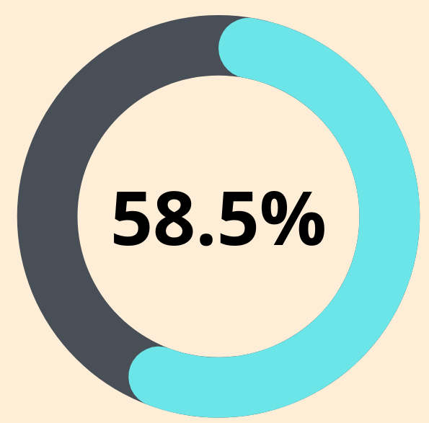
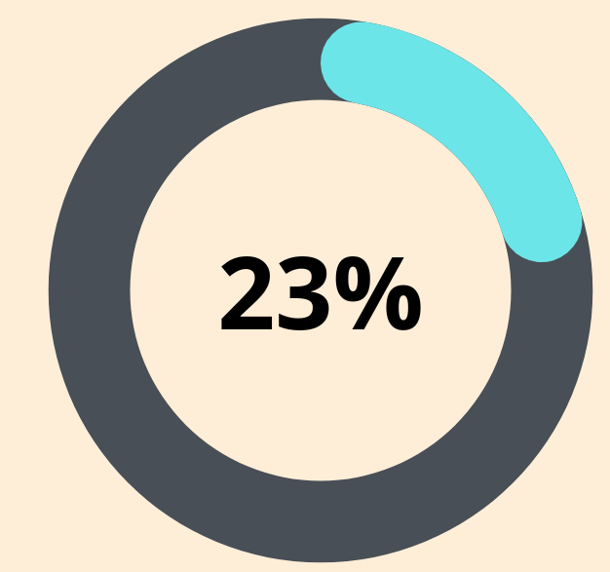
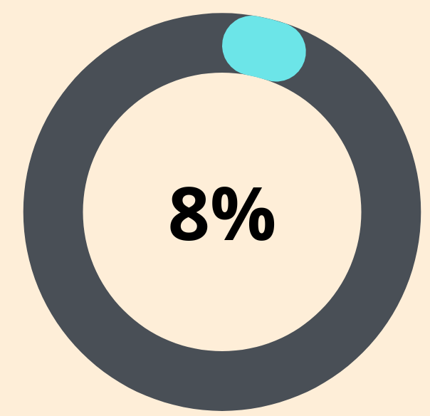
HCV Case Management Service South West Statistics
156
91 Consumers tested HCV RNA + (including 2 x re-infected)
Consumer contacts
21 consumers completed treatment and achieved SVR (including 1 x re-infected* and 2 x deceased)
7 consumers completed treatment, require SVR testing (including 1 x re-infected)*
56
require
follow-up*
2 consumers prescribed treatment but did not commence
5 consumers commenced treatment, but lost contact and/or did not complete
*to the best of our knowledge; may have had additional services conducted elsewhere
Notes:
HCV Case Management service data… 156 consumer contacts
91 consumers tested HCV RNA positive (including 2 x re-infected)
0 Current HCV treatment
2 consumers prescribed treatment but did not commence
5 consumers commenced treatment, but lost contact and/or did not complete
7 consumers completed treatment, require SVR testing (including 1 x re-infected)
21 consumers completed treatment and achieved SVR (including 1 x re-infected and 2 deceased)
56 consumers require follow up for treatment, assessment, and/or confirmatory HCV RNA testing*
*to the best of our knowledge; may have had additional services conducted elsewhere).

Slide 10
Consumer Intervention Statistics
Perth
99 consumers seen for HCV treatment overall since role began (July 2017)
2504 total contacts
9408 interventions
6140 interventions re: BBV/HCV
South West
35 consumers seen for HCV treatment overall since role began (July 2019)
543 total contacts
1004 interventions
564 interventions re: BBV/HCV

Slide 11
Differences for South West
Geographical areas covered
Greater Perth metro area
= 6,400 km² / ~2,000,000 people
South West region
= 24,000 km² / ~200,000 people
VS
Staffing
NP based in and works predominantly in Perth
VS
NP visits South West service once a month
Consistent staffing
VS
Availability of RN and changes to HCV Case Management staffing
Incentives
Incentive for testing
SOUTH WEST
PERTH
No incentive
VS

Slide 12
Why our model works
No appointments – open door policy
Flexible, low threshold service – no intake, no catchments, no exclusion criteria
Responsive to consumer needs – increase and/or decrease support as requested by the consumer
Speak the language of the consumer – peer shared experience and relatable vernacular builds trust and rapport
Nurse and Peer worker give each other credibility with consumer: health nous + street smarts = win win
Meeting consumers in their space shows willingness to work outside usual mainstream healthcare constraints

Slide 13
Difficulties and barriers
Changing contact details and transient lifestyle
Shifting priorities
Staffing availability, competing program requirements and securing right staff for the role
Re-infection
COVID19 - staff / COVID19 - consumers
Notes:
Changing contact details and transient lifestyles – requires perseverance and patience, but no loss of “place in queue” upon re-engagement
More immediate concerns or crises frequently take priority over addressing asymptomatic HCV
Priorities shift according to circumstance, despite positive/committed initial engagement
Staffing availability, competing program requirements and securing right staff for the role
Re-infection – despite best intentions and being fully informed
COVID19 for staff: complete clinic closure and/or limited ability for face to face consult or service delivery. No home visits/outreach conducted during this time
COVID19 for consumers: service closure or disruption impacting on usual supports available

Slide 14
Difficulties and barriers
Increased drug prices equals less disposable income
Unable to maintain daily pharmacotherapy payments
Lower engagement with any service and BBV becomes lower priority
Increased rental prices and cost of living
Difficulty keeping appointments as a result of less stable housing or homelessness
Notes:
Increased drug prices = less disposable income, compounded by increases in rental prices and for some the ability to maintain daily pharmacotherapy payments
For a number of consumers this meant even less money and difficulty keeping appointments as a result of less stable housing or homelessness
This potentially led to lower engagement with any service and less priority in dealing with BBV testing, HCV treatment commencement and engagement.

Slide 15
World Health Organization:
Plan to Eradicate HCV by 2030
Fact or fiction?
How else can we engage meaningfully with people who inject drugs?

Slide 16
Questions?
www.harmreductionwa.org
Jodie Savage
HCV Case Management Worker
mnsep@harmreductionwa.org
Paul Jeffery
HCV Case Manager Worker
outreach2@harmreductionwa.org

