Slide 1


Multicultural Community Leader Regional Extension Project – Hepatitis B
Notes:
As an extension of existing project we have employed a community leader Virginia Pitts who is also the president of the Peel multicultural assoc and peel citizen of the year 2021
Virginia has also been nominated for an ward for her service to the Multicultural community by OMI

Slide 2
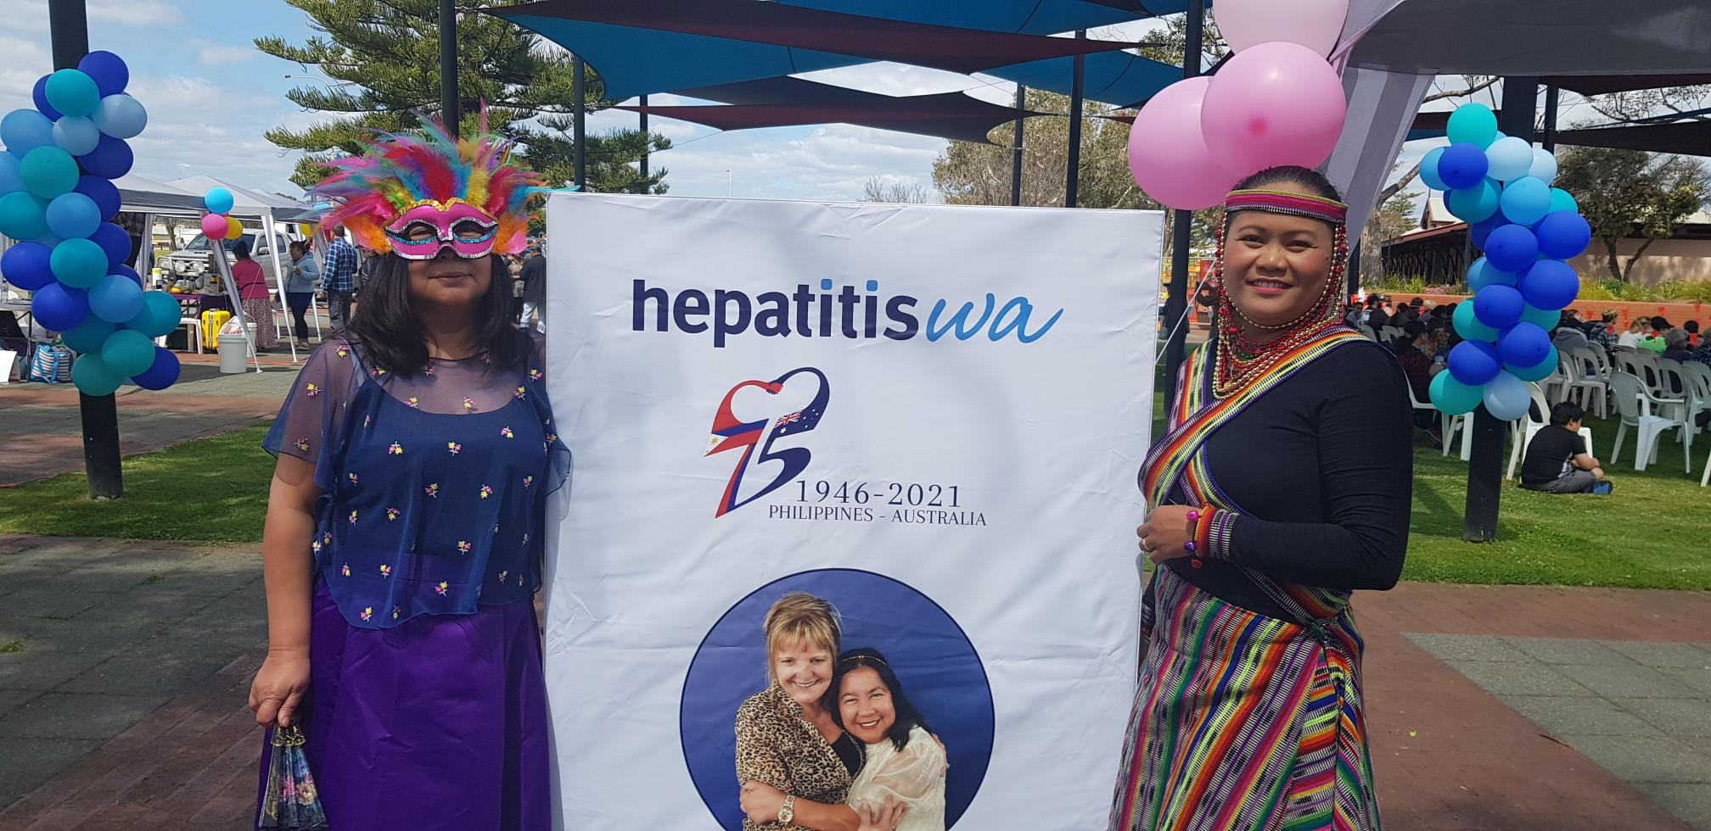
Regional Hepatitis B Program
Regional Partnerships/networking
Interactive Education
Regional Local Champions
Regional GP Pathways
Events
Notes:
There are 5 main parts to the Hep B program at HepatitisWA
Developing Connections with partner organisations is essential
Only after partnerships and trust have been built can education and workshops commence
Identifying regional champion
Hep b GPS in th eregions

Slide 3

1. Partnerships 2022
Partnerships 2022
Filipino Harvey association
Multicultural Arts and Culture - Bunbury
The Orange Story - Geraldton
Filipino Southwest Assoc. - Bunbury
Our Lady of Penafrancia, Mandurah
Peel Multicultural Association – Mandurah
Midwest Multicultural - Geraldton
Notes:
As we are a community it is important to acknowledge our current working partners, they include:

Slide 4
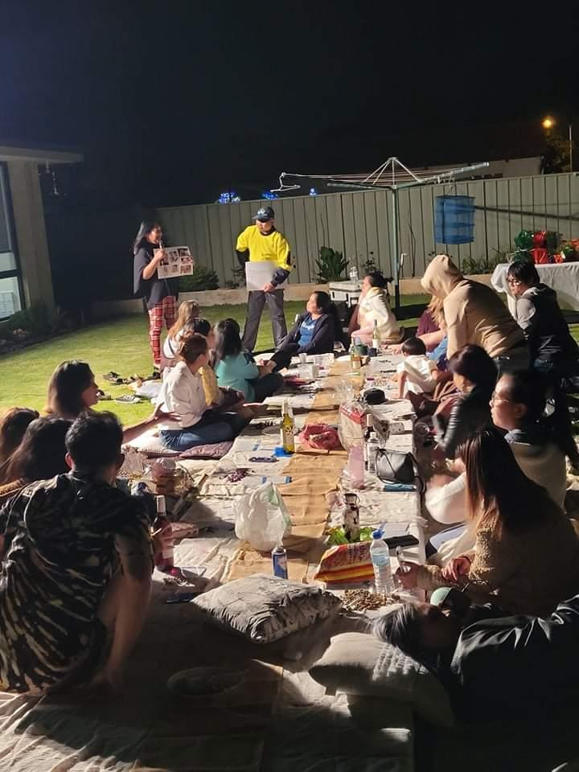
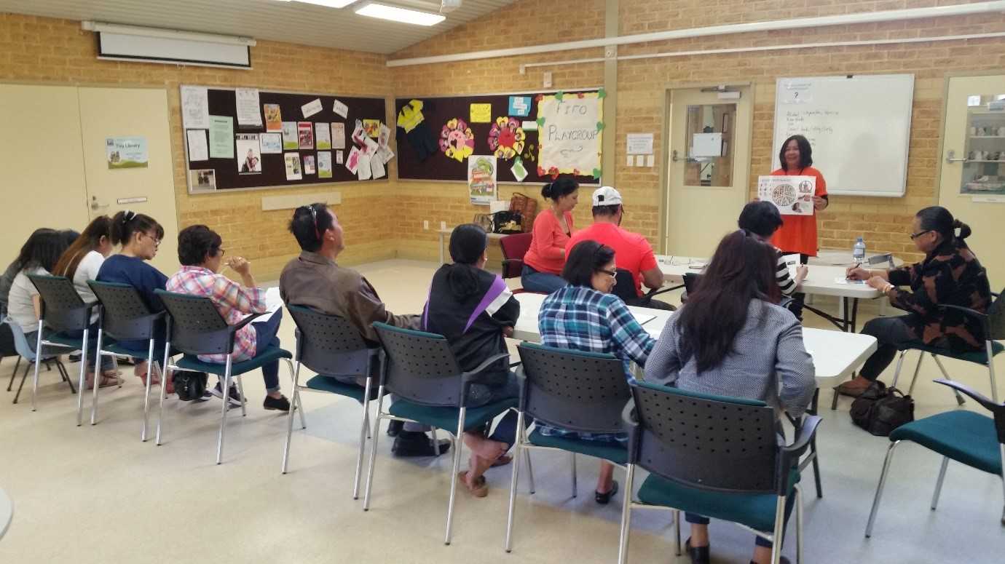
2. Education Sessions
Notes:
All participants attending education and workshops are given a pictorial evaluation to complete. Last reporting period
7 workshops reaching 159 regional cald participants

Slide 5
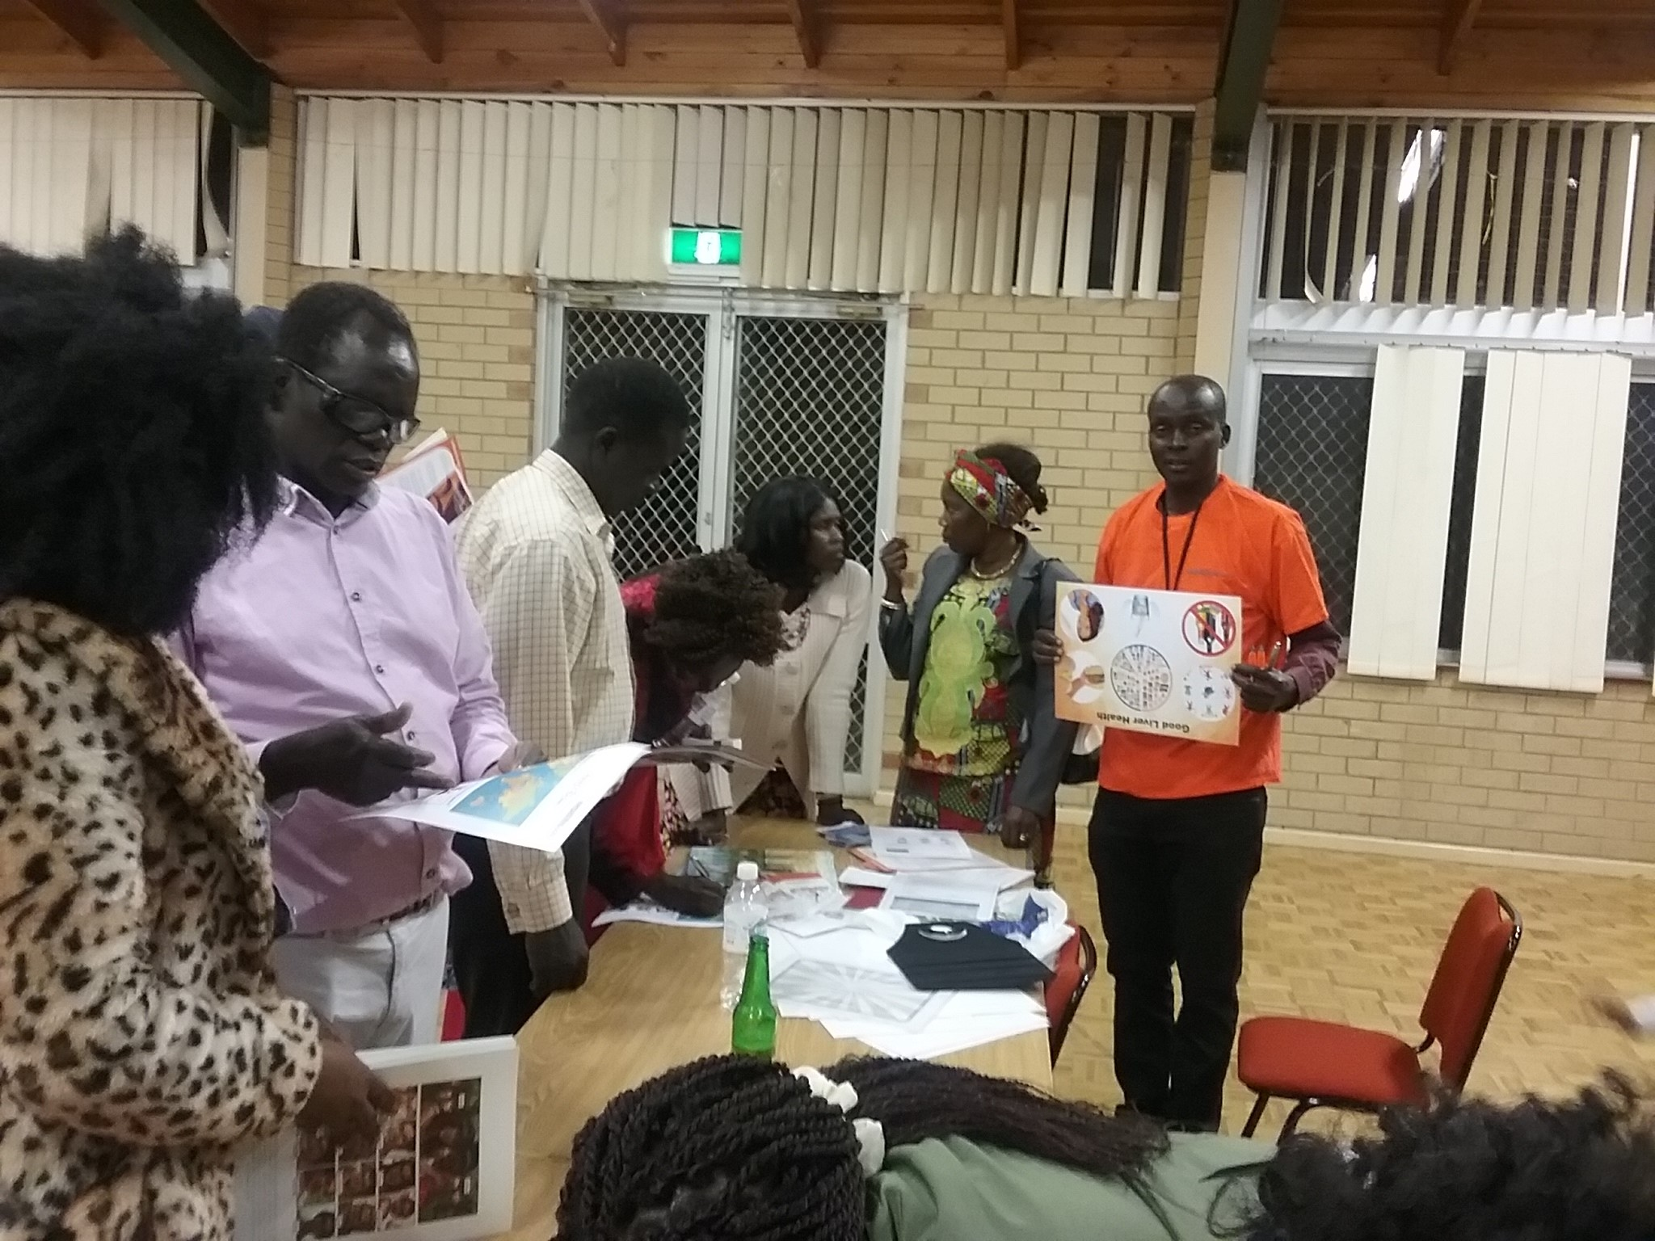
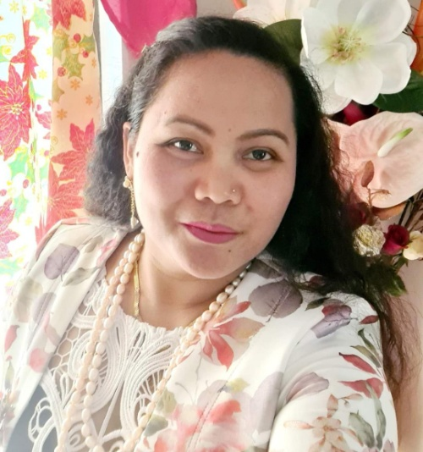
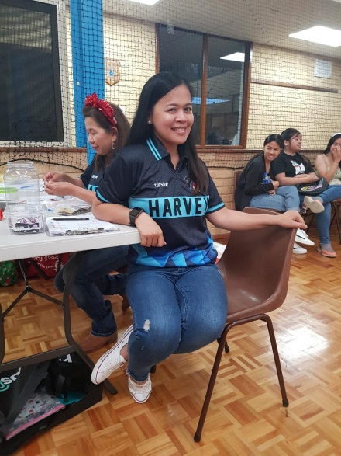
3. Increasing Reach – Regional Champions
3 x Bunbury Regional Champions
2 x Harvey Regional Champions
1 x Newman Regional Champion
1x Geraldton Regional Champion

Slide 6
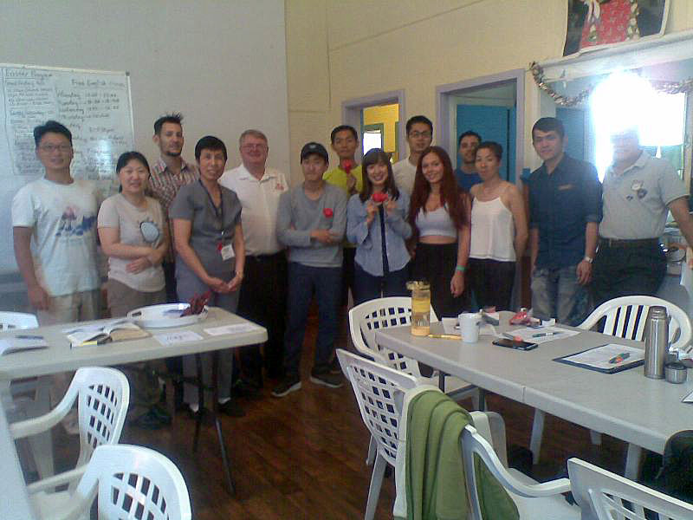
Purpose of Regional Champions
Facilitate GP pathways for community
Reduce fears and anxiety for testing
Speaking in their language provides a greater understanding
People feel more comfortable to share and discuss
40% have reported getting tested and vaccinated
Notes:
By having a community leader employed we have found
Education talks Reduce fears and anxiety for testing
Speaking in their language provides a greater understanding by providing correct information which includes myth busting.
People feel more comfortable to share and discuss health issues
40% of participants have reported getting tested and vaccinated
This program has been designed to upskill community leaders and to broaden the reach especially to men.
Regional champions are trained to help facilitate pathways to the GP and to help dispel myths and misinformation about hep b

Slide 7


4. Regional GP Pathways
Bunbury – Brecken Health
Harvey – Medical Group
Notes:
GP Location
Name of GP
Medical Centre (Affiliated)
Bunbury
Dr. Nerissa Pecache
Brecken Health Medical
Bunbury
Dr. Rebecca Lows
Brecken Health Medical
Harvey
Dr Singh
Harvey Medical group

Slide 8
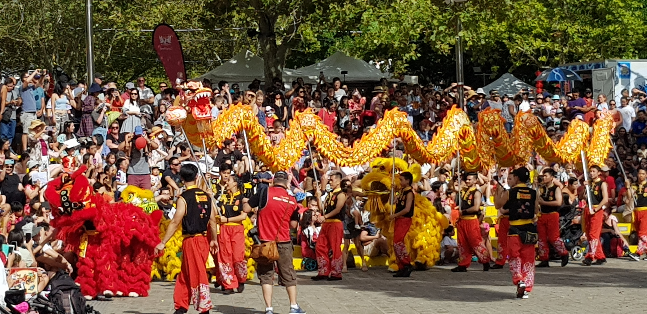
5. Events
Notes:
Leadership Awards night
Maskara festival bunbury
Mereghan festival Mandurah
Filipino culture long table Dinner Kwinana
Filipino Radio Perth aired worldwide
Chung wah festival
Filipino fiesta festival Harvey

Slide 9
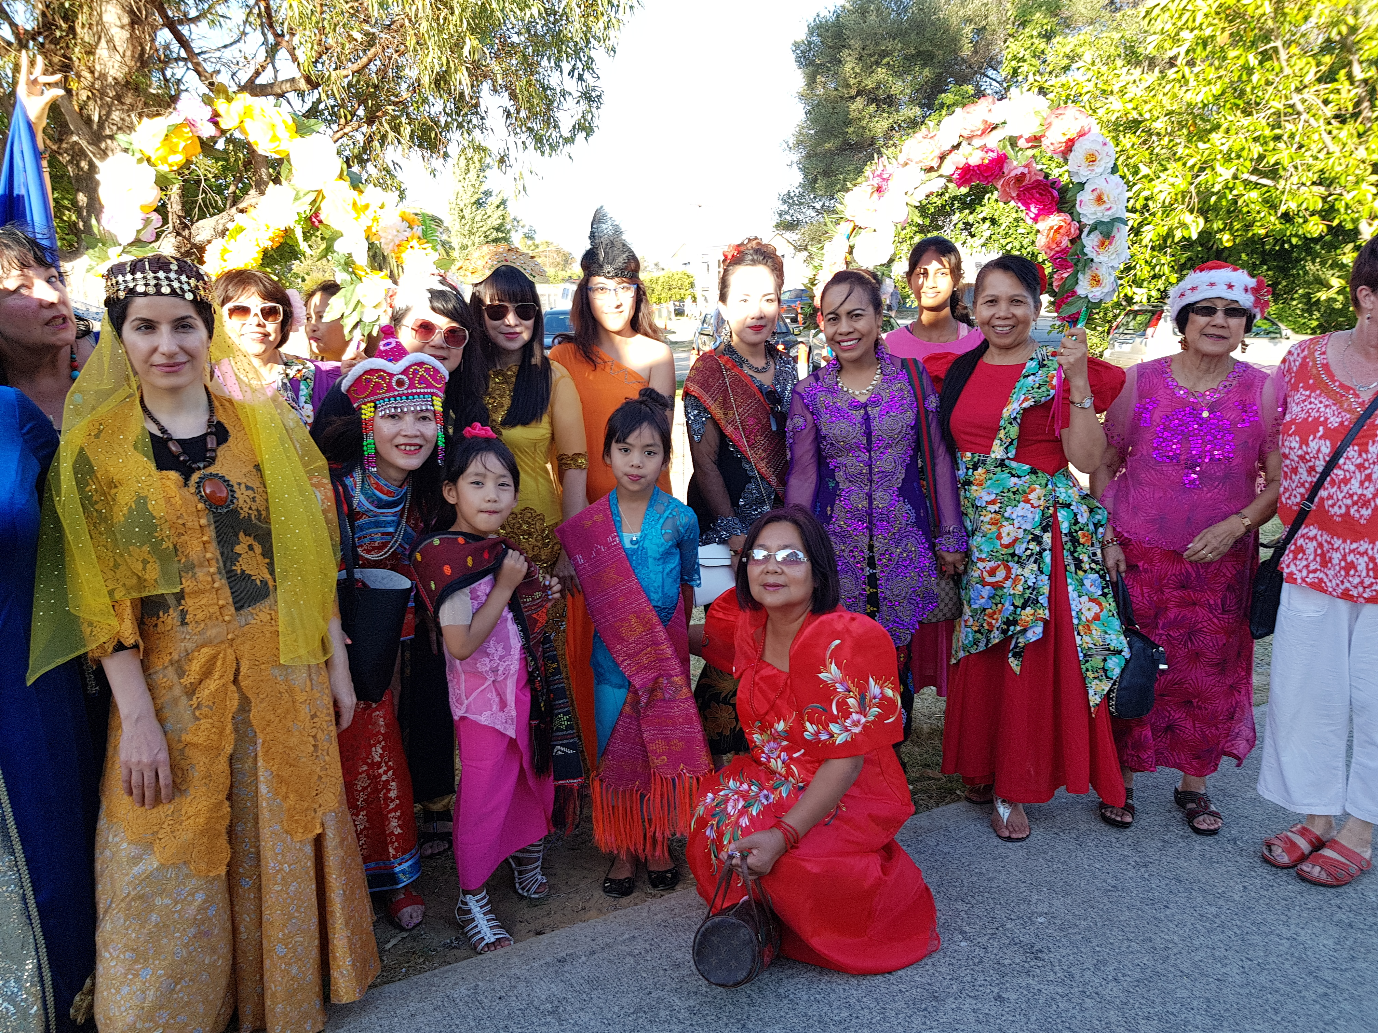
Notes:
Virginia is employed by Hep WA
She is president of the Peel Multcultural Association and citizen of the year for the peel district.

Slide 10
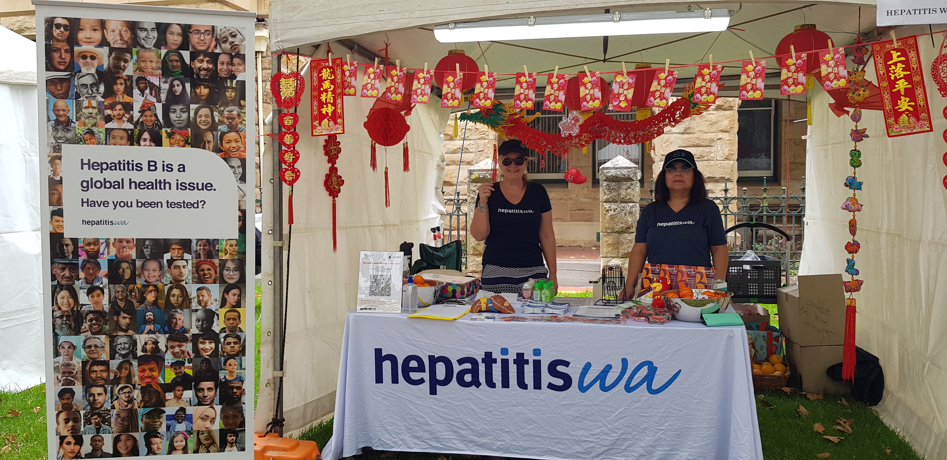

Slide 11
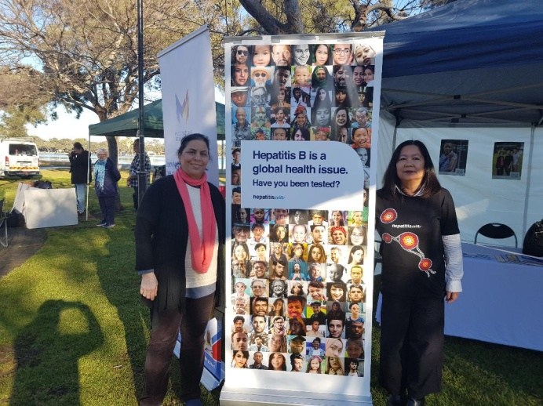
In Summary:
Partnership, Partnership, Partnerships
Engaging Regional Community leaders
Local Champions
Looking outside the box
GP pathways
Notes:
In summary:
Connections with partner organisations is vital but it takes time to build these relationships and to maintain them.
Being involved in multicultural network is so important to promote your services and develop relationships.
Valuing
Looking outside the box, has broaden our outlook to get to different communities.
We found You Can bring many communities together,.
Taking services to the people breaks down barriers and increases health literacy
AND LAST but not least Providing a Suite of education delivery styles that cater to all levels of English has been very well received.
.

Slide 12
Amanda Siebert Community Engagement
Virginia Pitts Community Development
Phone: (08) 9227 9800
e-mail: hepbcdo@hepatitiswa.com.au
Helpline: 9328 8538
Website: www.hepatitiswa.com.au
Notes:
Thank You for your time. ☺

