Slide 1
The YEP Project
SiREN Symposium 2022
#SyphilisOutbreakWA
Notes:
Intro: Bridget

Slide 2
Acknowledgement of Country

Slide 3
About the YEP Project
Notes:
Kai- intersex content

Slide 4
Introduce Yourself To Your Table

Slide 5
Topics We Cover
Healthy Relationships
Consent
Sexually Transmitted Infections (STIs) and Blood-Borne Viruses (BBVs)
Barrier Methods
Contraception
LGBTIQA+
Sexting
Porn
We are also open to hearing about your needs and may have capacity to develop something bespoke for you.

Slide 6
#SyphilisOutbreakWA
Notes:
Kai- intersex content

Slide 7
Development of the campaign
Use a peer-led approach.
Recruit paid peer educators to develop content; recruit from key syphilis affected communities.
Recruit a youth and sector reference group, ensuring representation from key SHBBV populations.
Recruit professional youth workers to support and guide the work.
Partner with peer informed sexual health services to support the development of content.
Conduct youth and youth sector consultations to identify knowledge gaps and preferred methods of communication.
Use targeted messaging.
Ensure accessibility.
Use multiple methods of delivery.
Use multiple platforms.
Repeat key messaging.
Mirror Department of Health messaging.
Respond to social media trends.

Slide 8
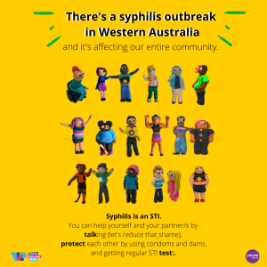
#SyphilisOutbreakWA
Available to download as a social media tile and poster size
https://theyepproject.org.au/blog/syphilis/

Slide 9
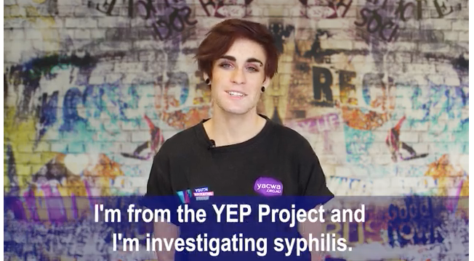
#SyphilisOutbreakWA
https://theyepproject.org.au/blog/syphilis/

Slide 10
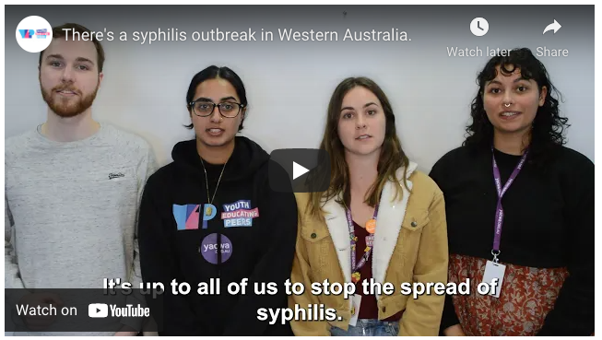
#SyphilisOutbreakWA
https://theyepproject.org.au/blog/syphilis/

Slide 11
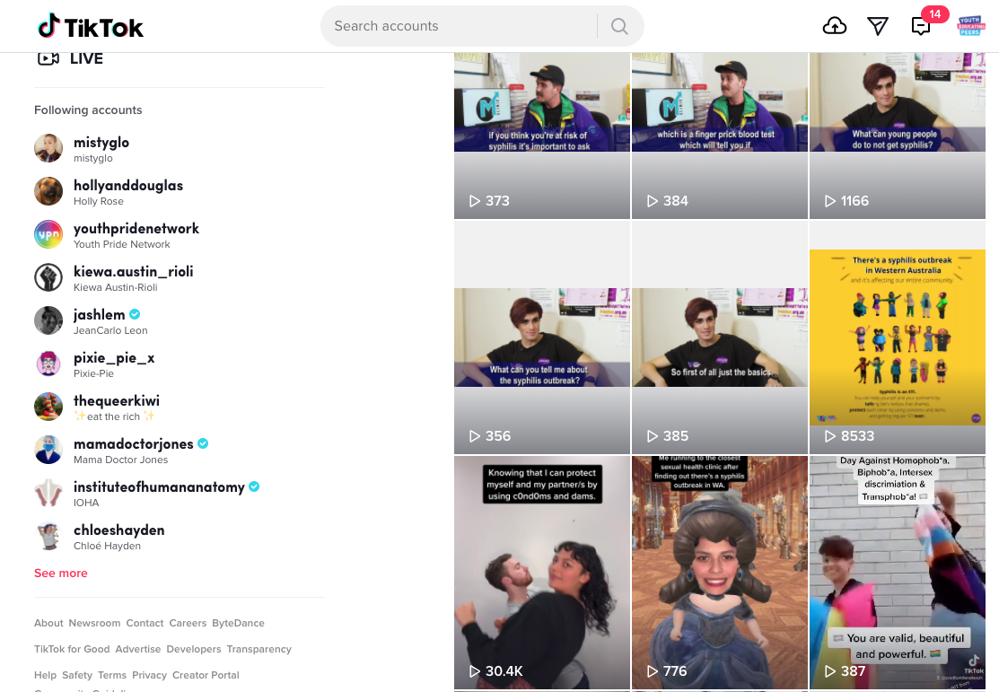
#SyphilisOutbreakWA
https://theyepproject.org.au/blog/syphilis/

Slide 12
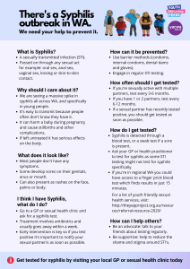
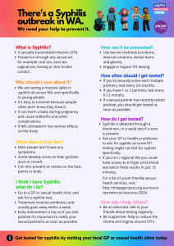
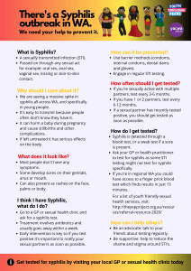
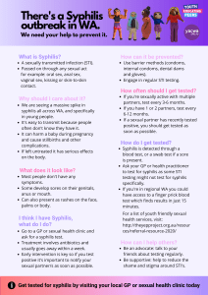
#SyphilisOutbreakWA
https://theyepproject.org.au/blog/syphilis/

Slide 13
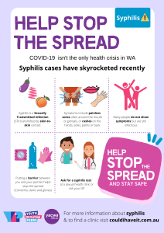
#SyphilisOutbreakWA
https://theyepproject.org.au/blog/syphilis/

Slide 14
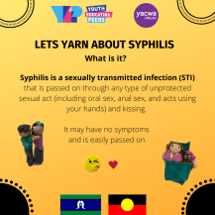
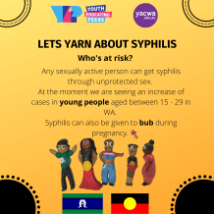
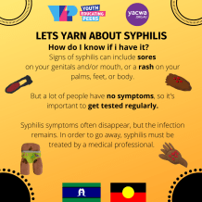
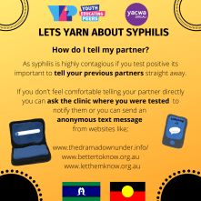
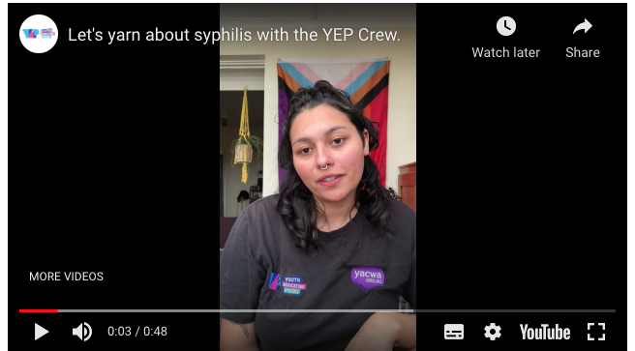
#SyphilisOutbreakWA
https://theyepproject.org.au/blog/syphilis/

Slide 15
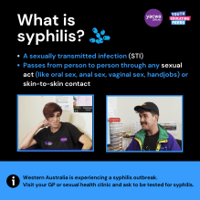
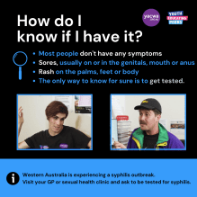
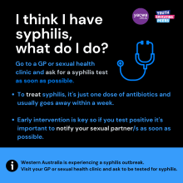
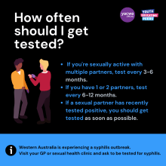
#SyphilisOutbreakWA
https://theyepproject.org.au/blog/syphilis/

Slide 16
Along side the campaign
Provide webinars, workshops and presentations for the youth sector to promote the content and to educate them on what they can do about the syphilis outbreak
Provide youth workers with access to the resources and text that can be easily shared with clients via text message, email and/or on social media.
Provide access to resources on a website, social media and emailed to a wide network of professionals.
Ensure easy downloads, png, and pdf versions for re-sharing and high quality printing to enable resources to be mailed to clients or displayed in community.
Promote the campaign in other sources

Slide 17
Significant outcomes
Significant outcomes have included increases in:
Engagement from target populations.
Social media following.
Knowledge about the syphilis outbreak, how to prevent, test and treat it
by young people and the youth sector.
Peer conversations about the syphilis outbreak.
Development of culturally appropriate content.

Slide 18
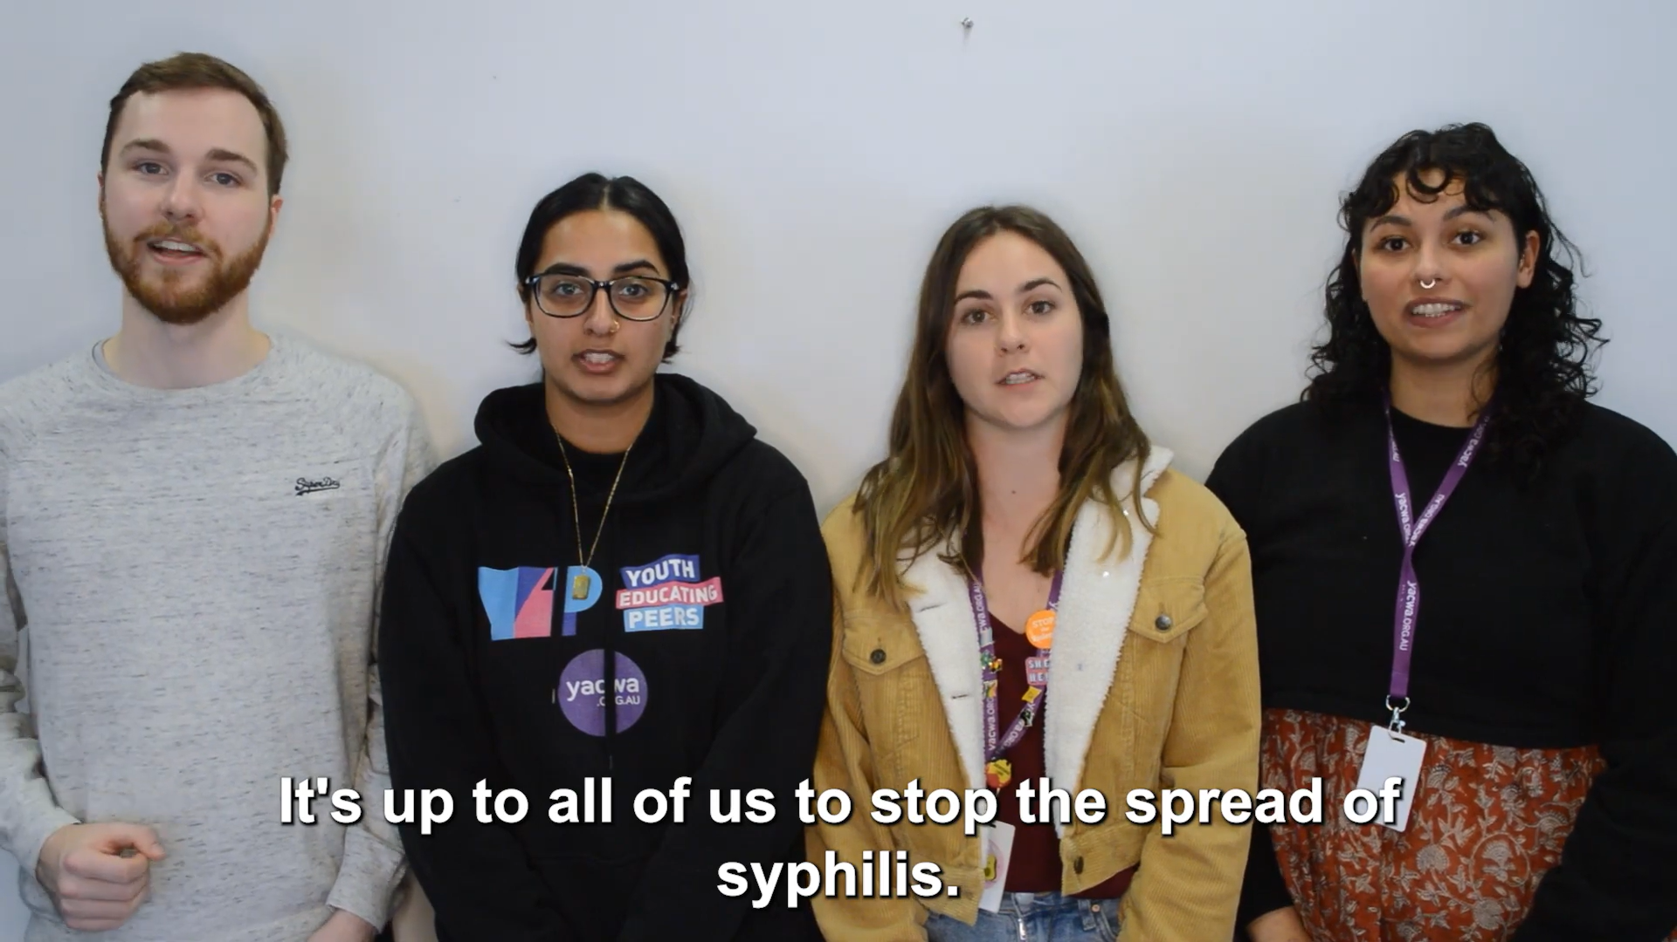
Conclusion
A multicultural and multimedia approach
should continue to be adapted to address STI outbreaks in the youth population.

Slide 19
Follow us for more

