Slide 1
Delivering an Alternative Community Response to the Recent Syphilis Outbreak in Priority Populations
Leanne Myers
Nurse Practitioner – Harm Reduction WA

Slide 2
Overview
Syphilis Project
Background
Methods
Results
Conclusions

Slide 3
Background
In response to the syphilis outbreak PBHRWA received a grant to promote and target syphilis testing and treatment utilising the most effective approach within our community
Rationale for van outreach:
Mobile health outreach services have the capacity to support the prevention and management of STIs and BBVs among people who inject drugs
The mobile health clinic will offer services across the cascade of care by providing clients with access to modes of prevention (provision of sterile injecting equipment, condoms, vaccinations for hepatitis B, increased access to testing for STIs and BBVs and access to appropriate treatments for positive cases
Increasing opportunities for prevention, testing and treatment will facilitate better health outcomes and reduce the likelihood of onward community transmission

Slide 4
Background
Focus on reducing stigma and discrimination around testing and treatment amongst target populations
The grant will also enhance the delivery of the outreach model of health services currently provided to our target population
PBHRWA was a successful applicant for SIREN to develop an evaluation protocol and data collection tools to enable our organisation to evaluate the effectiveness of the mobile health clinic.

Slide 5
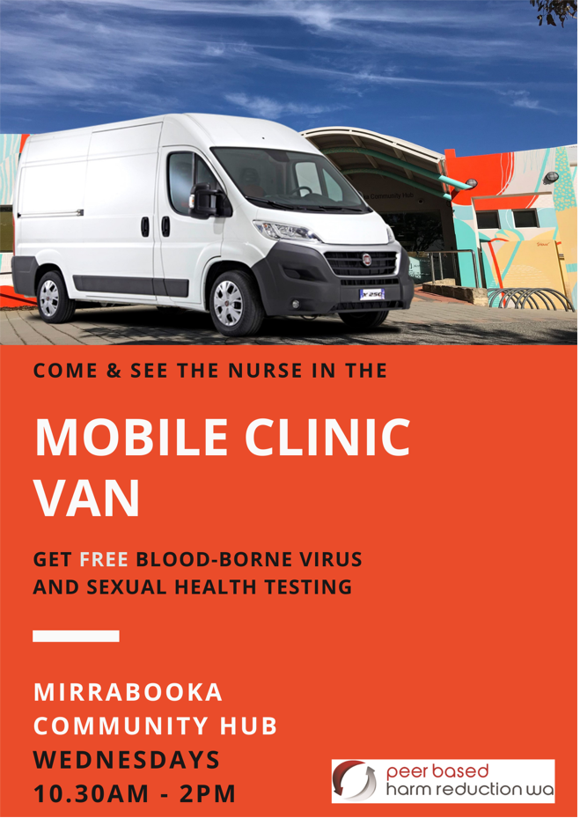
How did we do it?
Health professionals undertook SPOCT training and non-health staff undertook specific syphilis education
Resources developed and appropriate STI education was sourced
Stakeholder agency consultations and collaborations were undertaken in relating to siting the van

Slide 6
How did we do it?
Perth Fixed Site
Perth Mobile Van
Bunbury Fixed Site
Mobile NSEP
Patients referred from the NSEP and outreach
SPOCT offered as part of normal screening
Van purchase
Van fit-out
15 organisations contacted
Nov 2021- mobile clinics commenced
28 mobile clinics
2 staff – 1 health professional, 1 outreach worker
Patients referred from the NSEP and outreach
SPOCT offered as part of normal screening
MNSEP already in operation
16 organisations contacted
July 2021 mobile clinics commenced
9 mobile clinics
2 staff – 1 health professional, 1 outreach worker
Notes:
The Australian Needle Syringe Program Survey is a cross-sectional bio-behavioural surveillance system that recruits >2000 PWID annually in Australia.
Data has shown from between 2015 to 2019 thee has been a substantial increase in the proportion of HCV diagnosed PWID who intiated treatment and were cured. While the number of PWID with active HCV infection has more than halved over a 3.5 hear period.

Slide 7
Data Collection
Prevention
Vaccinations – HAV, HBV
Sterile injecting equipment
Condoms
Testing
STIs
BBVs
Treatments
BBVs
STIs

Slide 8
Data Collection
Prevention:
Sterile
injecting
equipment
80
Vaccinations
14
Condoms
100

Slide 9
Demographic characteristics
Demographic characteristics | Perth n=72 |  | South-West n=38 |  | Overall n=110
 | Number | % | Number | % | Number | %
Gender Male Female | 50 22 | 69.44 30.56 | 17 21 | 44.74 55.26 | 67 43 | 60.91 39.09
Age 16-25 26-40 41-55 56+ Missing | 11 16 29 14 2 | 15.28 22.22 40.28 19.44 2.78 | 8 13 13 4 0 | 21.05 34.21 34.21 10.53 0.00 | 19 29 42 18 2 | 17.27 26.36 38.18 16.36 1.82
Aboriginal/ Torres Strait Islander | 7 | 9.72 | 9 | 23.68 | 16 | 14.55
CaLD | 1 | 1.39 | 3 | 7.89 | 4 | 3.64
Injecting drug use Past Current | 16 13 | 22.22 18.06 | 13 10 | 34.21 26.32 | 29 23 | 26.36 21.15
Notes:
You may have noticed that CALD clients were underrepresented – this may be due to the locations that the van visited – Accommodation services – backpackers in the SW and in Perth accommodation services for the economically disadvantaged.
However this may be corrected when we continue to conduct outreach at the Mirrabooka community centre.

Slide 10
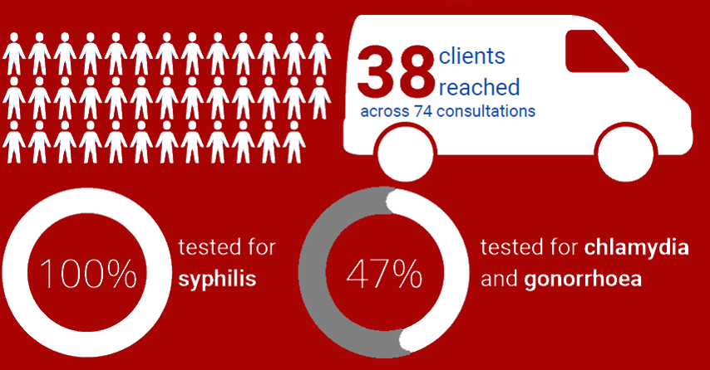
72
clients reached
across 114 consultations
tested for syphilis
14%
tested for chlamydia and gonorrhoea
79%
100%
Perth
Mobile Clinical Services
Dec 2021- 16 May 2022
tested for:
HIV
HAV & HBV
tested for HCV
(point-of-care)
50% antibody/RNA test
41%
38%
case of HCV identified through antibody/RNA testing
4
positive HCV point-of-care tests

Slide 11
clients reached
across 74 consultations
tested for syphilis
tested for chlamydia and gonorrhoea
Southwest
Mobile Clinical Services
Jul – Dec 2021
100%
47%
tested for:
HIV
HAV & HBV
tested for HCV
(point-of-care)
34% antibody/RNA test
34%
63%
case of HCV identified through antibody/RNA testing
positive HCV point-of-care tests

Slide 12
Overall Test Positivity Results
Tests conducted | Perth |  | South-West |  | Overall
 | Number positive cases | Test positivity rate (%) | Number positive cases | Test positivity rate (%) | Number positive cases | Test positivity rate (%)
Hepatitis C antibody/RNA (Perth: n=36) (SW: n=13) | 1 | 2.78% | 1 | 7.69% | 2 | 4.08%
Hepatitis C GeneXpert (Perth: n=27) (SW: n=24) | 4 | 14.81% | 3 | 12.50% | 7 | 13.72%
Chlamydia (Perth: n=10) (SW: n=18) | 1 | 10.00% | 0 | 0.00% | 1 | 3.57%
Gonorrhoea (Perth: n=10) (SW: n=18) | 0 | 0.00% | 0 | 0.00% | 0 | 0.00%
*SHBBVP annual epidemiological report 2020
Notes:
I would like to draw your attention to the RNA/Antibody test positivity rate is much higher than the general population which has a test positivity rate of 4.08%
The test positivity rate for chlamydia of 3.57 is comparable to the general population which has a test positivity rate of 4%

Slide 13
Testing rates
STI/BBV test | Perth/SW n-=110 | Epidemiological data*
Syphilis(any test) | 86% | 4.5%
HIV | 40% | 5.6%
HBV | 39% | 6.4%
HCV | 90% | 5.8%
Chlamydia/Gonorrhoea | 25% | 7.7/7.5% respectively
Clients visiting or clinics are tested at a higher rate than people in the general population
*SHBBVP annual epidemiological report 2020
Notes:
I thought this was an important slide to highlight.
So although the comparison is not strictly a direct one, as the epidemiological data is per 1000 people population whereas our data is our population I think it tells a meaningful story.
Clients visiting or clinics are tested at a higher rate than people in the general population

Slide 14
Outreach Worker Interventions
Peer Outreach Workers
Perth
SW
Outreach worker engaged with clients:
Outreach worker engaged with clients:
BBV/STI 75% (292/390)
BBV/STI 85% (118/138)
Drug health 1% (5/390)
Other health 1.5% (6/390)
Other health 14% (20/138)
Other non-health 58% (226/390)
390
Brief interventions
138
Brief interventions
Outreach workers provide the link between the client and the health professional
Notes:
Since 2017 our model of care has evolved to include peer workers.
Initially we identified tasks that could be performed by peer workers who were at the frontline of the service.
Peer workers received HCV education and undertook phlebotomy training enabling them discuss HCV treatment options and to address any consumer concerns.
WE have two hepatitis C case management workers – 1 in Perth and 1 in Bunbury. who support people to engage in HCV testing and treatment and then follow the patient through the treatment process by providing weekly phone calls, medication delivery, and transport to other appointments.
The HCV case management worker also coordinates outreach visits which we conduct fortnightly.
The aim of this program was to increase access to and participation in blood borne virus testing and hepatitis C treatments.
Consumers had access to testing 5 days a week as an outreach worker who had undertaken phlebotomy training was able to perform phlebotomy at the fixed site in Bunbury and on the mobile needle and syringe exchange van.

Slide 15
Service Partner Satisfaction in SW
Partner agency survey responses to question, “To what extent do you agree or disagree with the following statements: The PBHRWA mobile health clinic…” (n=5)
Partner agency survey responses to question, “To what extent do you agree or disagree with the following statements…” (n=5)
The PBHRWA mobile health clinic is … | Strongly agree | Agree | Disagree | Strongly disagree | Neither agree nor disagree
Is a valuable resource for clients of my service | 4 (80.00%) | 1 (20.00%) | 0 (0.00%) | 0 (0.00%) | 0 (0.00%)
Meets the needs of clients of my service | 3 (75.00%) | 0 (0.00%) | 0 (0.00%) | 0 (0.00%) | 1 (25.00%)
Helps to address an unmet need in the sector in which I work | 2 (50.00%) | 1 (25.00%) | 0 (0.00%) | 0 (0.00%) | 1 (25.00%)
Complemented the work of my service | 2 (50.00%) | 2 (50.00%) | 0 (0.00%) | 0 (0.00%) | 0 (0.00%)
Statement | Strongly agree | Agree | Disagree | Strongly disagree | Neither agree nor disagree
I was satisfied with the way in which PBHRWA communicated with my service in relation to the mobile health clinic | 4 (80.00%) | 1 (20.00%) | 0 (0.00%) | 0 (0.00%) | 0 (0.00%)
I would like to see my service continue its partnership with PBHRWA mobile health clinic | 4 (80.00%) | 1 (20.00%) | 0 (0.00%) | 0 (0.00%) | 1 (25.00%)
The partnership with the PBHRWA mobile health clinic did not interfere with my service’s ability to perform its core functions | 4 (80.00%) | 1 (20.00%) | 0 (0.00%) | 0 (0.00%) | 1 (25.00%)

Slide 16
Incentivising Syphilis Testing
Received $2000 to incentivise syphilis testing
$10 per person (finger prick test or phlebotomy)
Patient receives $10 once test completed and signs a form
Commenced April 2022
Increased testing
on the day by
50%

Slide 17
Program Improvements
Dedicated hours for syphilis project health and outreach staff
More partnerships with CALD agencies
Possible extension to other regional areas
Need to incorporate into normal clinic activities

Slide 18
Conclusion
During this data collection, although there was no syphilis detected, however, there are advantages to normalising syphilis testing and increasing awareness in priority populations
The steps involved in testing a client also serve as a type of health
promotion and function to raise community awareness
The mobile health clinic plays an important role in preventing transmission

Slide 19
Thank you
Acknowledgements
Peer Outreach Workers
SHBBVP
SIREN

