Slide 1
A Rapid Review of Interventions to Increase Hepatitis B Testing, Treatment, and Monitoring among Migrants Living in Australia
Vishnupriya Rajkumar¹, Dr Kahlia McCausland^{2*}, Dr Roanna Lobo³
¹ Master of Public Health Student, School of Population Health, Curtin University ² Senior Research Officer, SiREN, School of Population Health, Curtin University ³ Senior Lecturer, School of Population Health, Curtin University * Presenting author

Slide 2
Background
Western Australian targets – by 2023¹
Increase the proportion of people living with chronic hepatitis B who are diagnosed to 80%.
Increase the proportion of people living with chronic hepatitis B receiving care to 50%.
Increase the proportion of people living with chronic hepatitis B who are receiving antiviral treatment to 20%.
Western Australian progress towards targets
From 2019 – 2020, the testing rate decreased by 8% (to 59/1,000 population) while the notification and test positivity rates increased by 15% (to 20/100,000 population) and 25% (to 0.21%).²
In 2020, an estimated 10.2% of people living with chronic hepatitis B were engaged in care.³
In 2020, an estimated 6.9% of people living with chronic hepatitis B were receiving antiviral treatment. ³

Slide 3
Background
Factors influencing diagnosis and treatment targets – hepatitis-related stigma, challenges adapting to new environments and healthcare systems, low levels of hepatitis B knowledge and awareness, and the asymptomatic nature of the disease.^{1,2,3}
Compounding pressures as a result of COVID-19 – disrupted routine vaccination campaigns and vaccine supply chains, altered transmission dynamics, and decreased diagnostic and treatment services.⁴
Currently, no national strategy to systematically screen those at risk for chronic hepatitis B in Australia exists.⁵

Slide 4
Individual, community-based, and structural interventions
Individual interventions: use person-centred strategies in a one-on-one setting, including education, advice, and counselling, to improve people’s knowledge, attitudes, skills, and behaviours, including uptake of testing and treatment adherence.¹
Community interventions: seek to improve the health of disadvantaged communities by improving social cohesion and mutual support and strongly emphasise lessening social stigma through group-based health promotion, education, advice, and counselling.^{1,2}
Structural interventions: such as policy change, attempt to improve the social, physical, economic, and political contexts that influence the standard of living achieved by the whole population and their importance in treating hepatitis B and other STI.^{3,4,5,6}

Slide 5
Aim
To conduct a rapid review of the available evidence on the effectiveness of interventions that aim to increase hepatitis B testing, treatment, and/or monitoring among migrants from culturally and linguistically diverse (CALD) backgrounds living in Australia and other high-income countries: the United Kingdom (UK), Canada, New Zealand (NZ), and the United States (US).

Slide 6
Methods
A comprehensive search of three databases (Medline, Embase, and Scopus) and two search engines (Google and Google Scholar) was conducted.
Search strategy:
- Grey and peer-reviewed literature (quantitative and qualitative)
- Published between January 2012 and December 2021
- Published in English language
- Studies included those conducted with first- and/or second- generation migrants from CALD backgrounds living in Australia, the UK, Canada, NZ, and the US

Slide 7
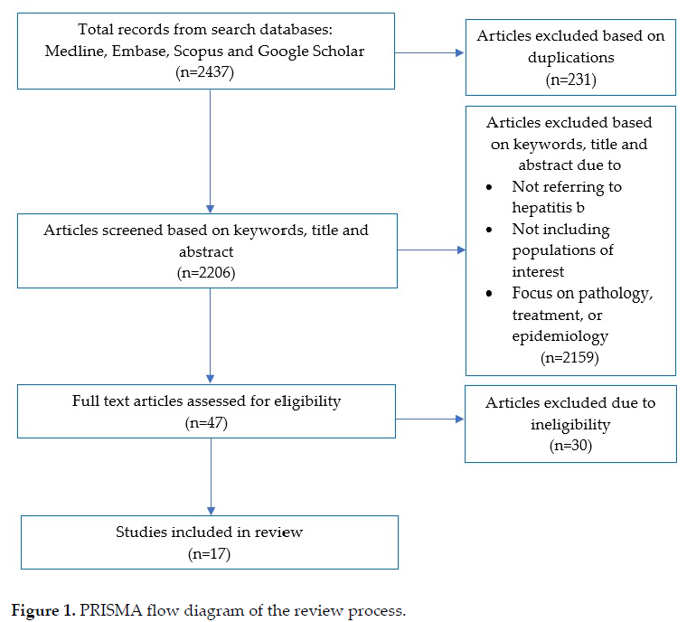
Results
Screening process overview

Slide 8
Overview of studies by country
5 studies UK
1 study Canada
9 studies USA
2 studies Australia
Total studies = 17

Slide 9
Overview of studies by intervention type
13 individual
1 structural
3 community
Total studies = 17

Slide 10
Individual interventions by country
3 studies UK
8 studies USA
2 studies Australia
Total studies = 13

Slide 11
Individual interventions – outreach testing
1 study UK
7 studies USA
1 study Australia
Total studies = 9

Slide 12
Individual interventions – outreach testing
Outreach efforts were effective in encouraging testing in all 9 studies.
8 studies identified hepatitis B prevalence in their target populations ranging from 3.0% to 9.6%.
6 studies showed evidence of linkage to care ranging from 28% to 97% of the participants.
No studies showed evidence of monitoring participants after they had been linked to care.
No eligible studies were found conducted in Canada.
Outreach testing strategies
6 studies conducted interventions in community-based settings, and 3 studies conducted interventions across both community and clinical-based settings.
All studies used linguistic-specific and culturally appropriate materials.
7 studies provided hepatitis B education in conjunction with screening events.
Other strategies employed included offering free vaccines, cash and travel-cost incentives, and dried blood spot sampling.

Slide 13
Individual interventions – provider-initiated testing
2 studies UK
1 study USA
1 study Australia
Total studies = 4

Slide 14
Individual interventions – provider-initiated testing
3 interventions were effective in encouraging up to 90% of their target population to engage in hepatitis B screening.
Only 1 study monitored HBsAg-positive or hepatitis B-non-immune individuals for three months post-intervention.
No eligible studies were found conducted in Canada.
Provider-initiated testing strategies
All studies were conducted in a clinical-based setting.
3 studies used linguistic-specific and culturally appropriate materials to communicate with their target populations.
Other strategies employed included providing general practitioners with education, a financial incentive, and clinician support; electronic health record prompts; and nurse-led contact tracing systems.

Slide 15
Community interventions by country
2 studies USA
1 study Australia
Total studies = 3

Slide 16
Community interventions
All 3 studies were effective in encouraging participants to consent to hepatitis B testing, ranging from 19% to 84% of their target populations.
No eligible studies were found conducted in Canada or the UK.
Community intervention strategies
2 studies conducted interventions across community and clinical-based settings, or in community settings only.
All studies used linguistic-specific and culturally relevant methods to communicate with their target populations.
Other strategies employed were education workshops and films, dried blood spot sampling, and chain-referral sampling methods.

Slide 17
Structural interventions by country
1 study UK
Total studies = 1

Slide 18
Structural interventions
1 study reported the results of a mandatory screening programme conducted in a clinical-based setting, and the testing yield was notably high at 2.0% (n = 188).
This study cited fear of legal implications affecting migrants’ rights to resettlement as a barrier to the self-reporting of risk factors for infectious diseases.
No eligible studies were found conducted in Canada, the US or Australia.

Slide 19
Implications for research, policy and practice
Research opportunities
Interventions should include the simultaneous use of evidence-based individual, community, and structural strategies.
Clinical practice opportunities
Interpreters should be recognised as an essential component of clinical services provided to migrants from CALD backgrounds, and hepatitis B education and awareness materials should be available in multiple languages.
Health promotion opportunities
The key features of programmes should correct culturally rooted myths and conceptions about hepatitis B transmission and educate participants on long-term risks and consequences to health.
Consultation and collaboration with relevant stakeholders, including community and religious leaders, should be considered to promote community dialogue and understanding to reduce stigma and discrimination.
Policy and advocacy opportunities
A universal tool for recording past immunisations is recommended.

Slide 20
Conclusion
To prevent further hepatitis B transmission and chronic viral hepatitis-related morbidity and mortality, there is a critical need for public health approaches that consider broader socioeconomic and sociocultural factors associated with migrants from CALD backgrounds.
Based on this review, interventions should utilise linguistic-specific and culturally appropriate resources to successfully engage migrants from CALD backgrounds, and community outreach programmes should educate participants to promote community dialogue and understanding to reduce stigma and discrimination.

Slide 21
Published paper
Citation: Rajkumar, V.; McCausland, K.; Lobo, R. A Rapid Review of Interventions to Increase Hepatitis B Testing, Treatment, and Monitoring among Migrants Living in Australia. Int. J. Environ. Res. Public Health 2022, 19, 5947. https://doi.org/10.3390/ijerph19105947
Contact details
Ms Vishnupriya Rajkumar | vishrajkumar89@gmail.com
Dr Kahlia McCausland | kahlia.mccausland@curtin.edu.au
Dr Roanna Lobo | roanna.lobo@curtin.edu.au

