Slide 1
The YEP Project
SiREN Symposium 2022
Innovative adaptions in youth sexual health education, in response to COVID-19.
Notes:
Intro: Bridget

Slide 2
Acknowledgement of Country

Slide 3
Presentation Overview
What we’re going to talk about:
- A bit about the YEP Project
- What our key aims were during COVID
- Lockdown learnings
- Future recommendations

Slide 4
About the YEP Project
Notes:
Kai- intersex content

Slide 5
Introduce Yourself To Your Table

Slide 6
Topics We Cover
Healthy Relationships
Consent
Sexually Transmitted Infections (STIs) and Blood-Borne Viruses (BBVs)
Barrier Methods
Contraception
LGBTIQA+
Sexting
Porn
We are also open to hearing about your needs and may have capacity to develop something bespoke for you.

Slide 7
Prior to COVID 19
Notes:
Kai- intersex content

Slide 8
Prior to COVID-19
Largely face-to-face
Traditionally offered face-to-face youth and sector development workshops, and a small amount of social media content.
A key focus of our work is to increase young people's engagement with local sexual health services and increase youth STI testing rates.
Notes:
Kai
8

Slide 9
Key aims during COVID
Notes:
Kai- intersex content

Slide 10
Key Aims During COVID-19
Provide responsive and engaging sexual health messaging
for young people and the youth sector.
Pivot to online delivery:
Increase YEP’s presence on social media to provide responsive and up-to-date information to young people directly and the youth sector.
Improve access for young people who do not have access to technology or the internet, create resources that are youth friendly, engaging and in easy English. Ensure that these can be easily used by young people independently, but can also be used by youth workers in their roles by downloading and shared directly with clients or posted to a location.
Provide topical and relevant youth sector professional development via webinars.
Provide youth services with youth peer webinars for their clients.
(this included services like the City of Kwinana, the Shire of Jarradahle and North Metro Tafe).
Provide messaging across a number of channels through a variety of mediums to increase reach of sub demographics and learning needs.
Notes:
Kai
10

Slide 11
Webinars
Youth Sector Webinars
via Zoom
Notes:
Kai
11

Slide 12
#SociallyDistantSTITesting
Notes:
Kai- intersex content

Slide 13
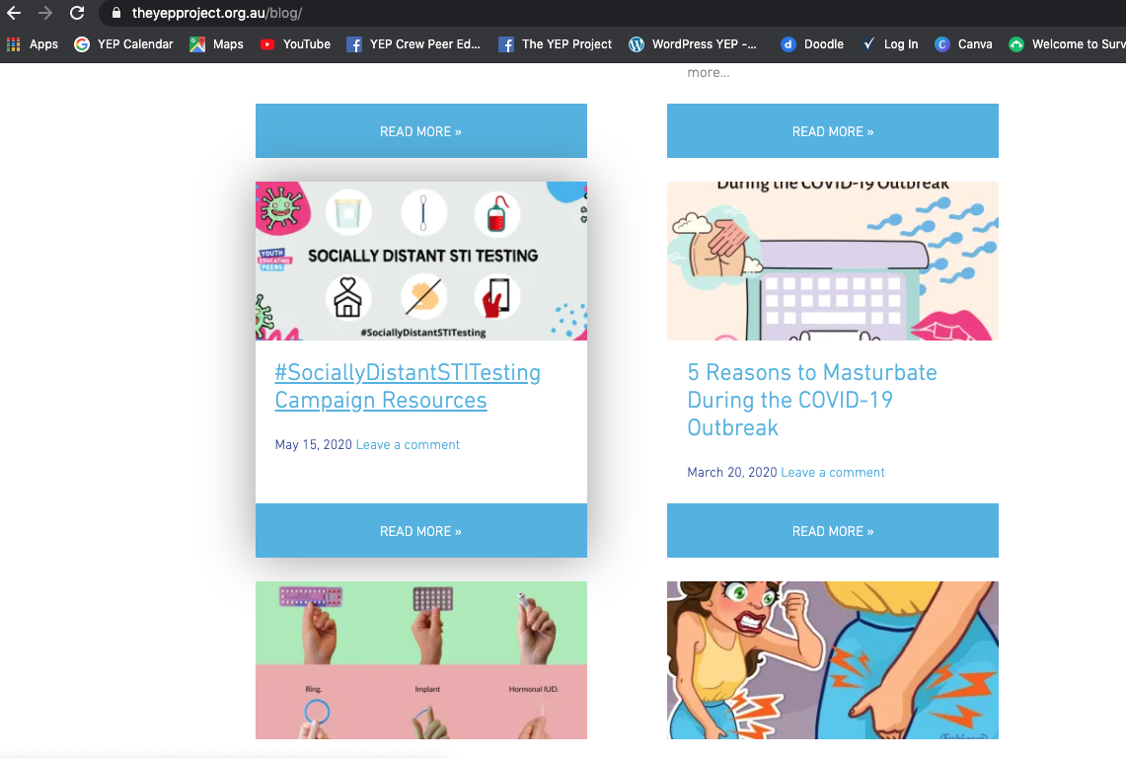
#SociallyDistantSTITesting
theyepproject.org.au/blog/sociallydistantstitesting-campaign-resources/
Notes:
Kai
13

Slide 14
#SociallyDistantSTITesting Campaign Resources
theyepproject.org.au/blog/sociallydistantstitesting-campaign-resources
Notes:
Kai
14

Slide 15
Educational Videos
Notes:
Kai- intersex content

Slide 16
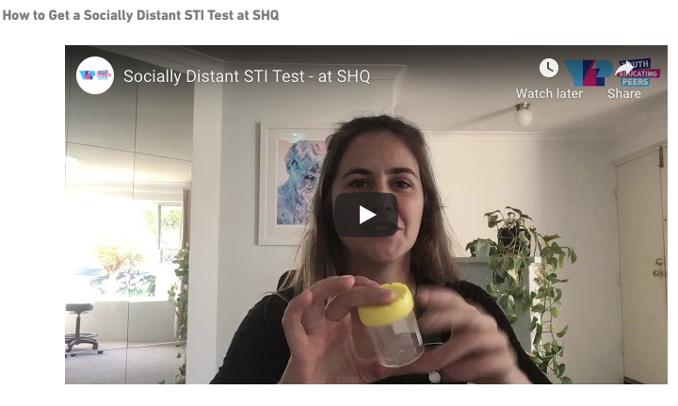
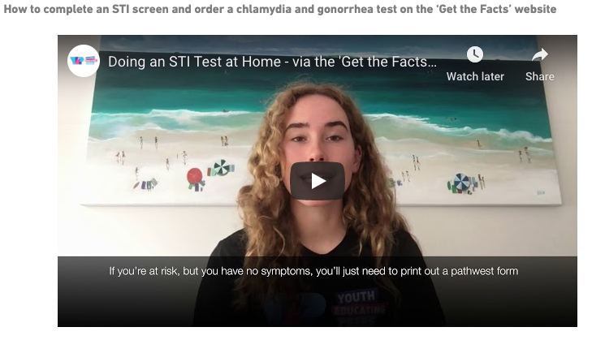
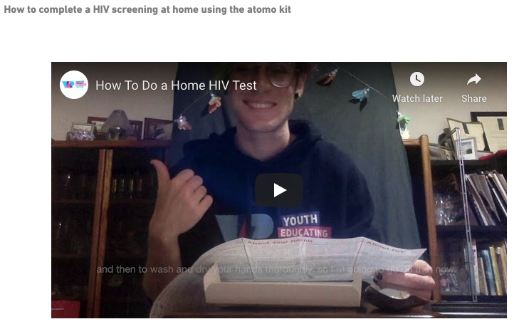
Educational Videos
theyepproject.org.au/blog/sociallydistantstitesting-campaign-resources
Notes:
Kai
16

Slide 17
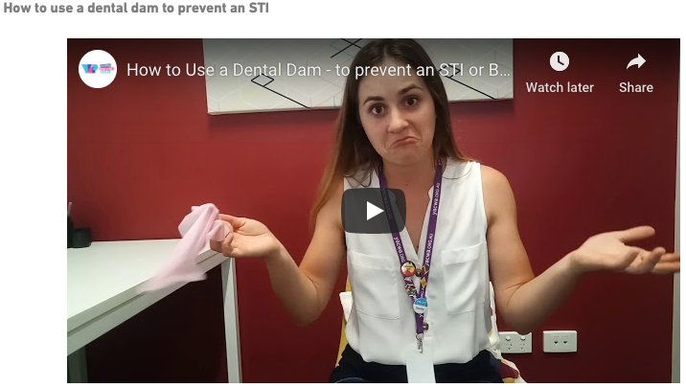
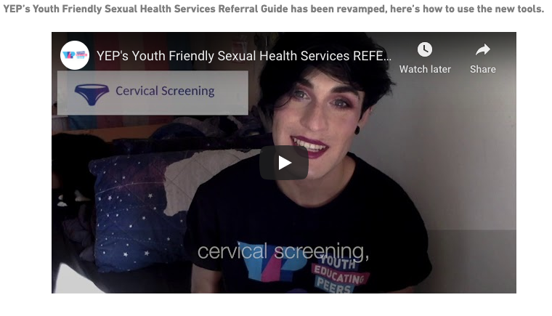
Educational Videos
theyepproject.org.au/blog/sociallydistantstitesting-campaign-resources
Notes:
Kai
17

Slide 18
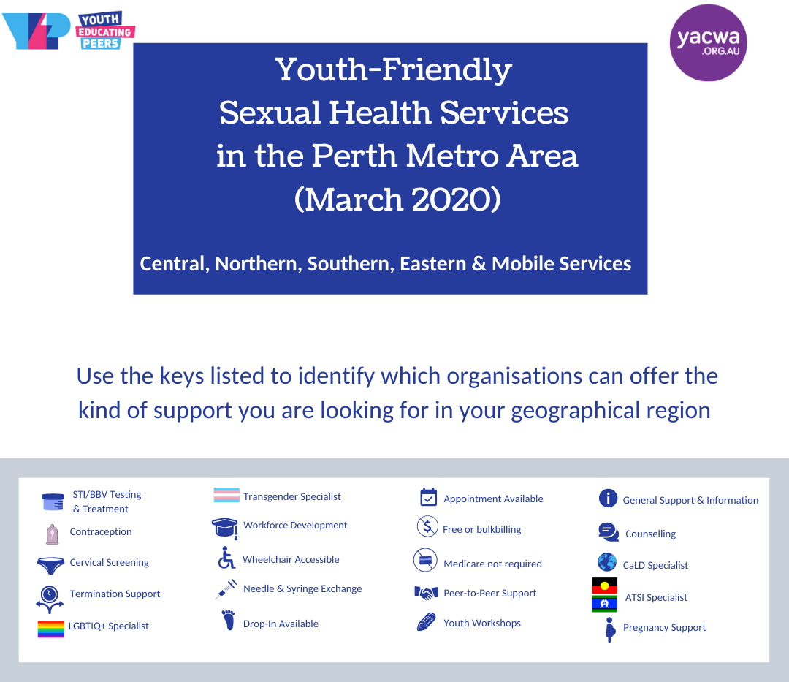
Youth Friendly Sexual Health Service
Referral Resource
Download from our website:
https://theyepproject.org.au/resources/referral-resource-2020/
Notes:
Kai
18

Slide 19
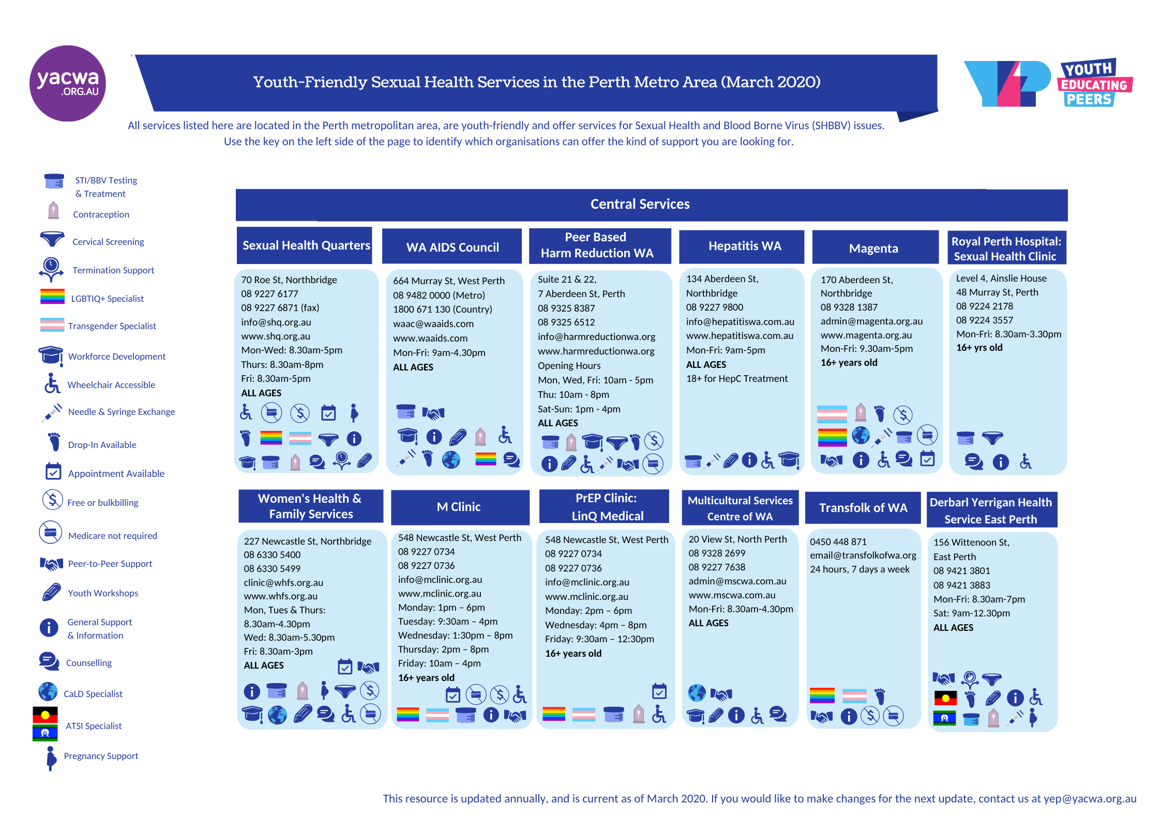
Youth Friendly Sexual Health Service
Referral Resource
Notes:
Kai
19

Slide 20
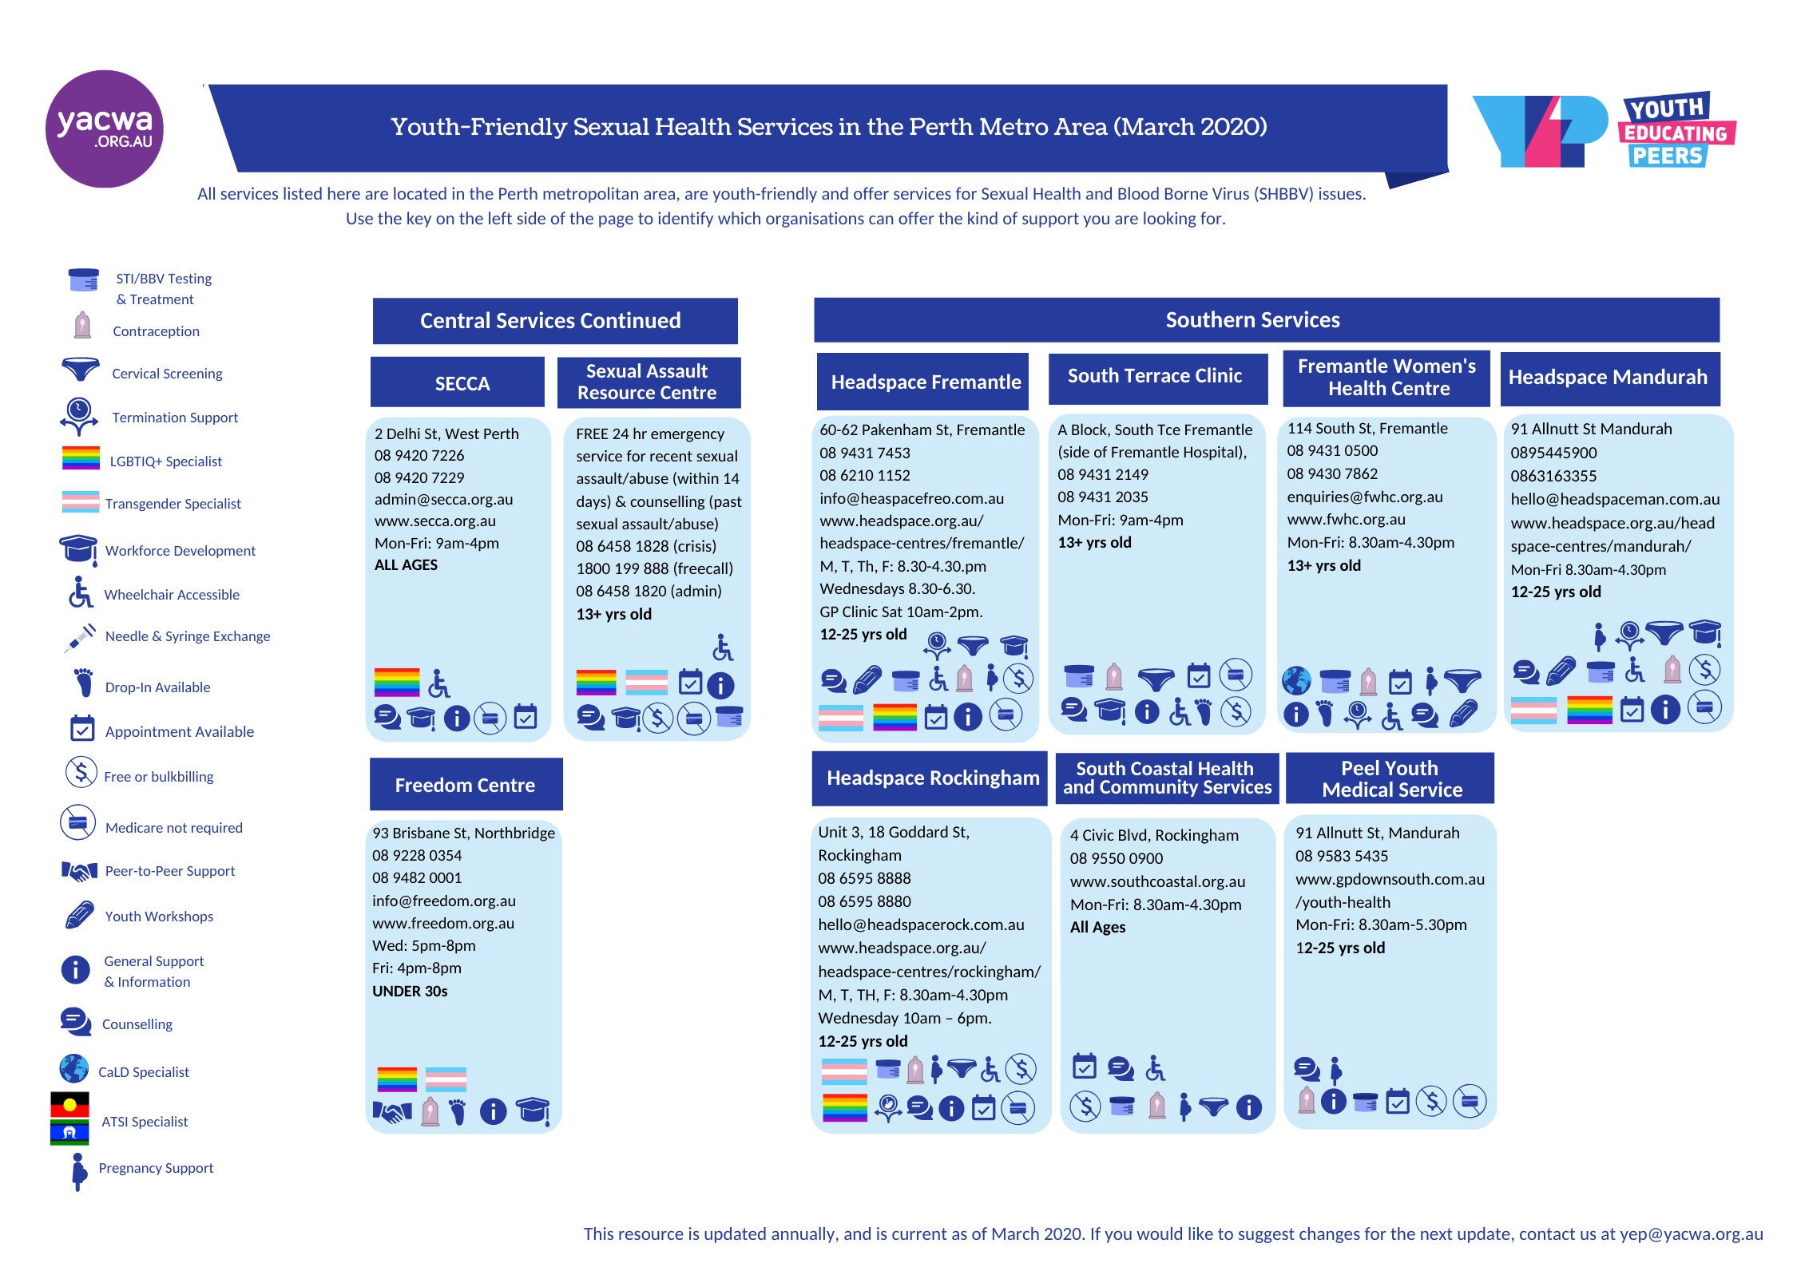
Youth Friendly Sexual Health Service
Referral Resource
Notes:
Kai
20

Slide 21
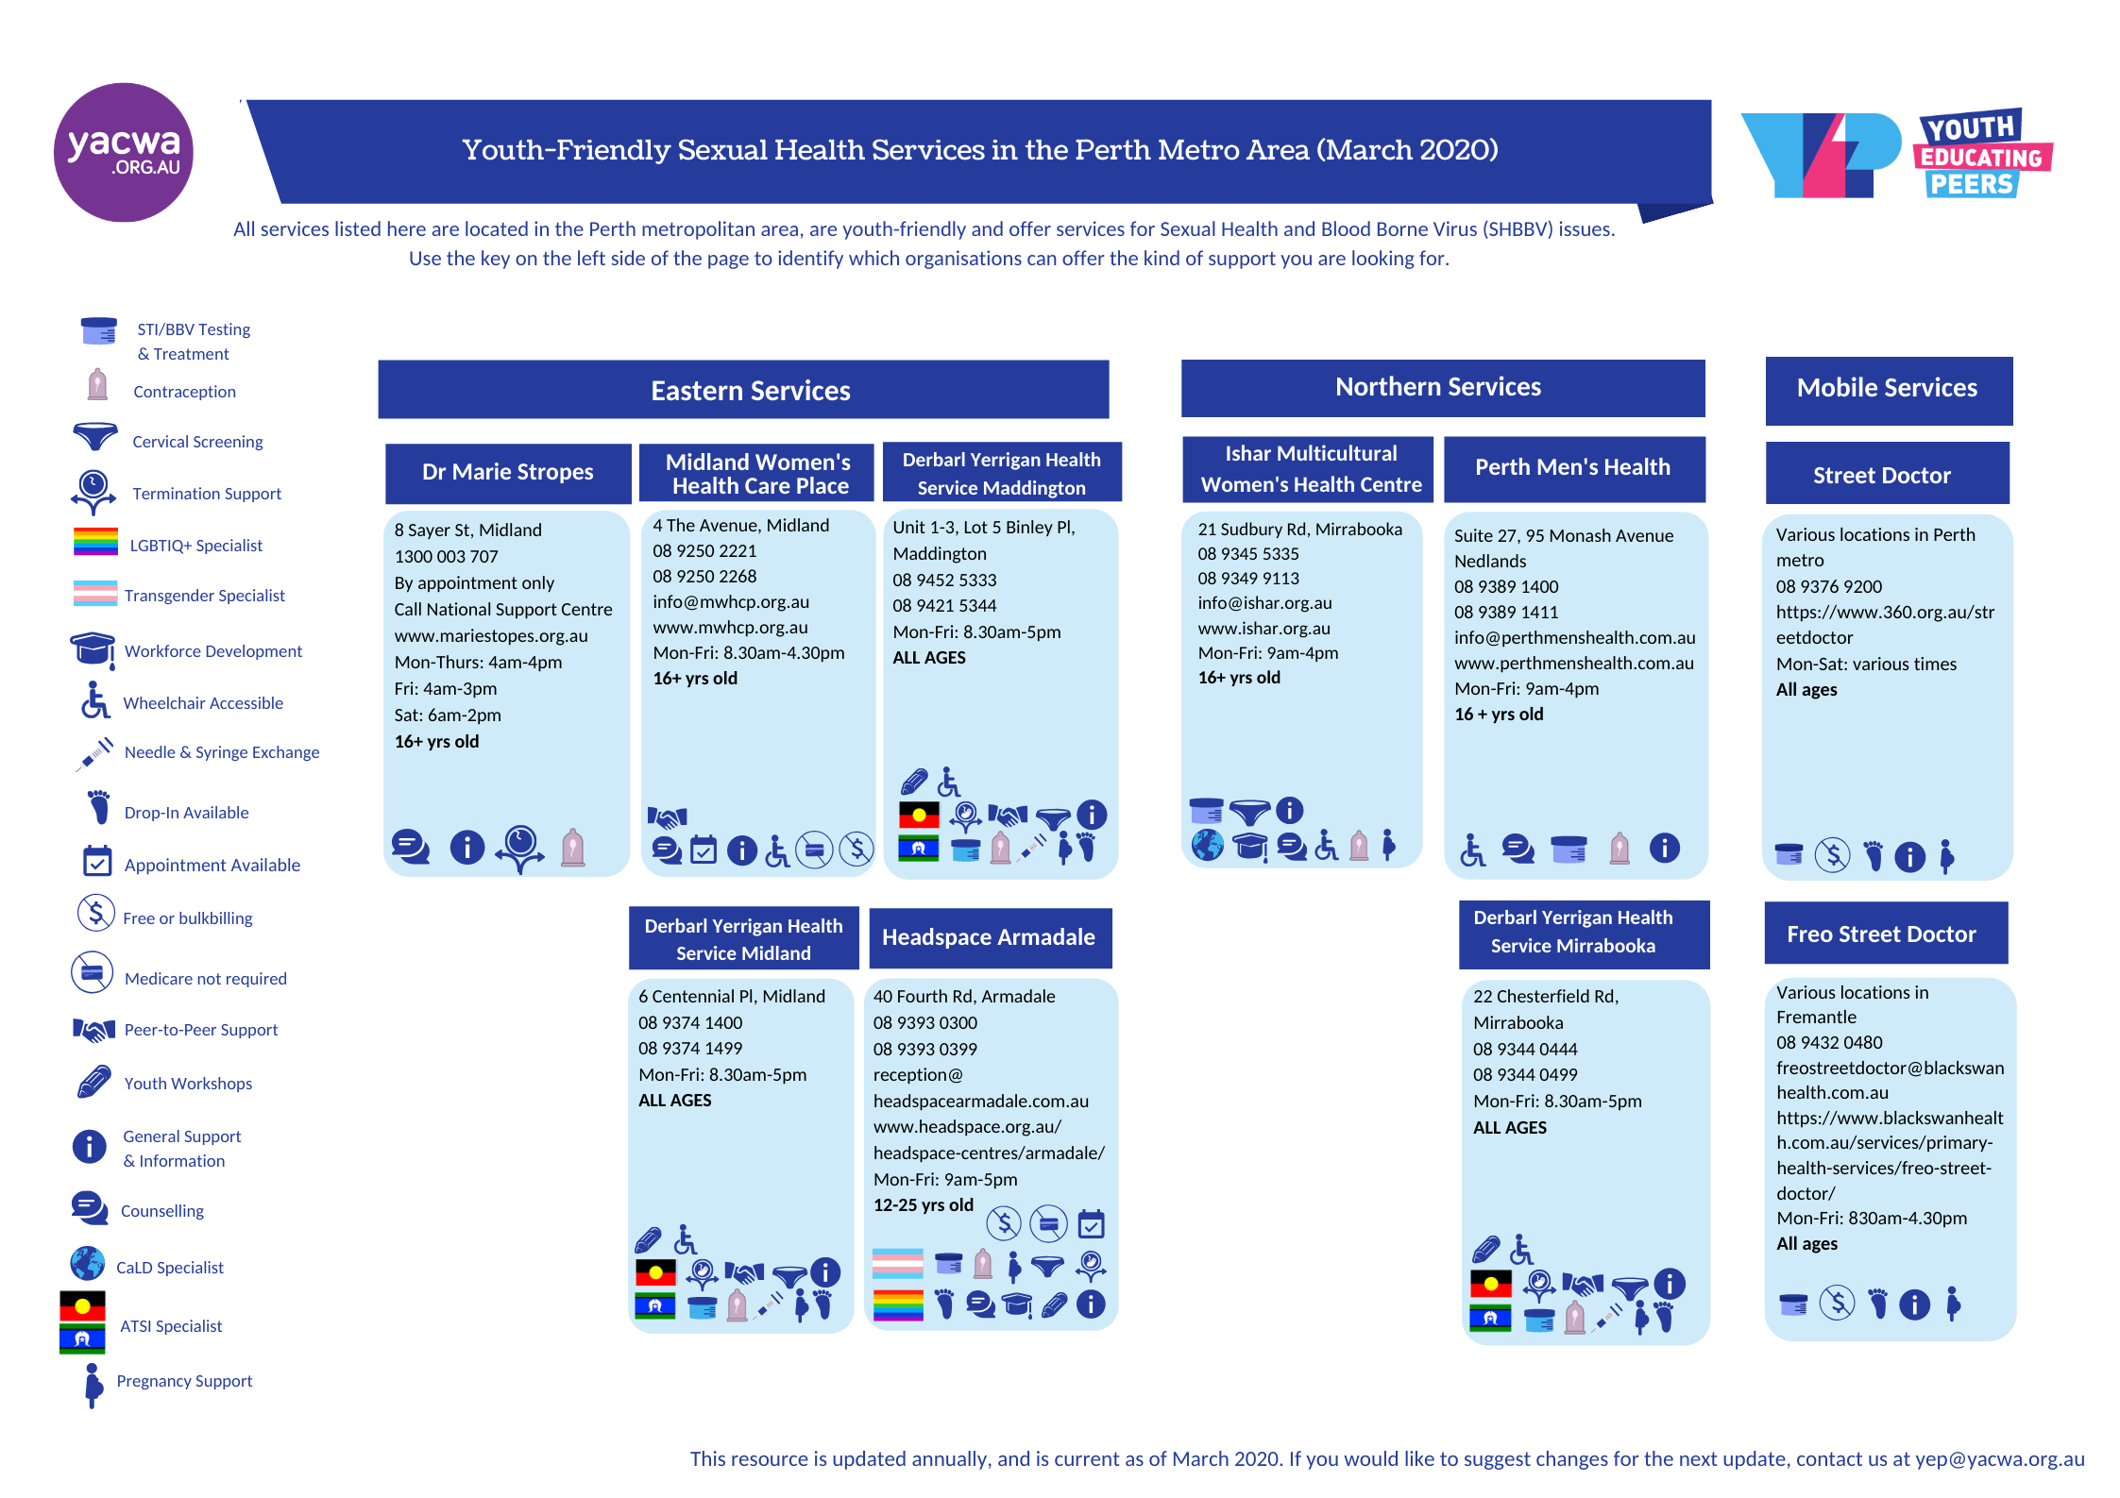
Youth Friendly Sexual Health Service
Referral Resource
Notes:
Kai
21

Slide 22
TikToks
Notes:
Kai- intersex content

Slide 23
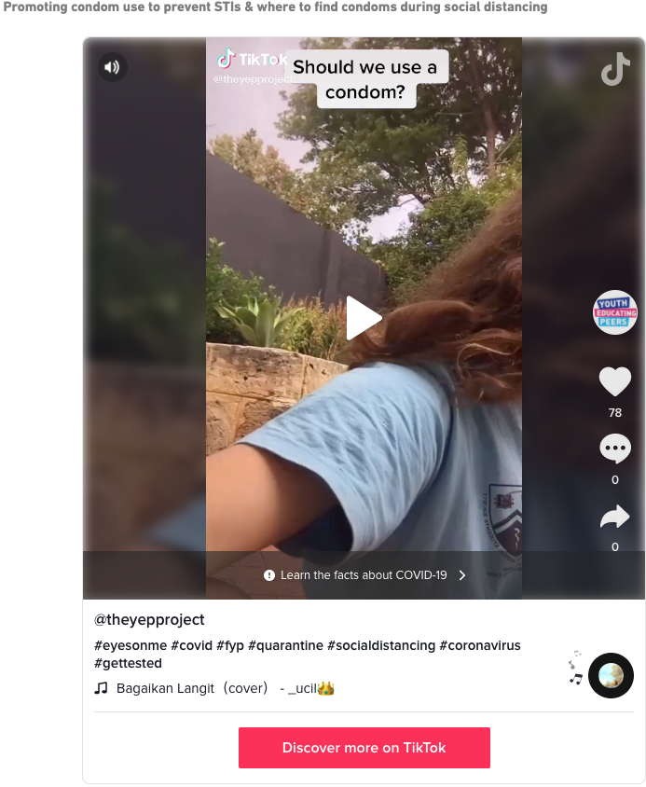
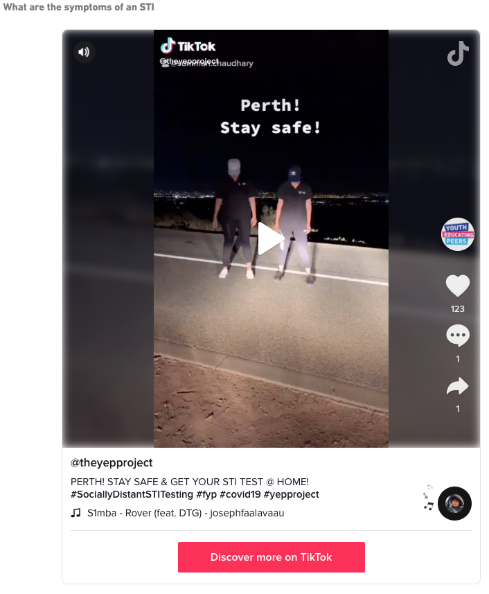
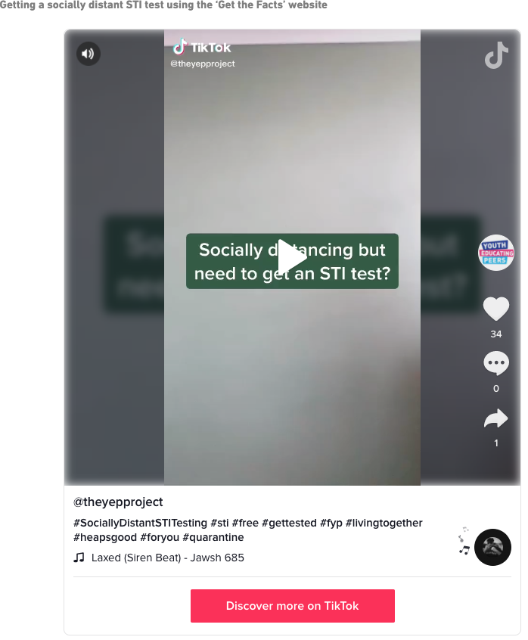
Educational Videos
theyepproject.org.au/blog/sociallydistantstitesting-campaign-resources
Notes:
Kai
23

Slide 24
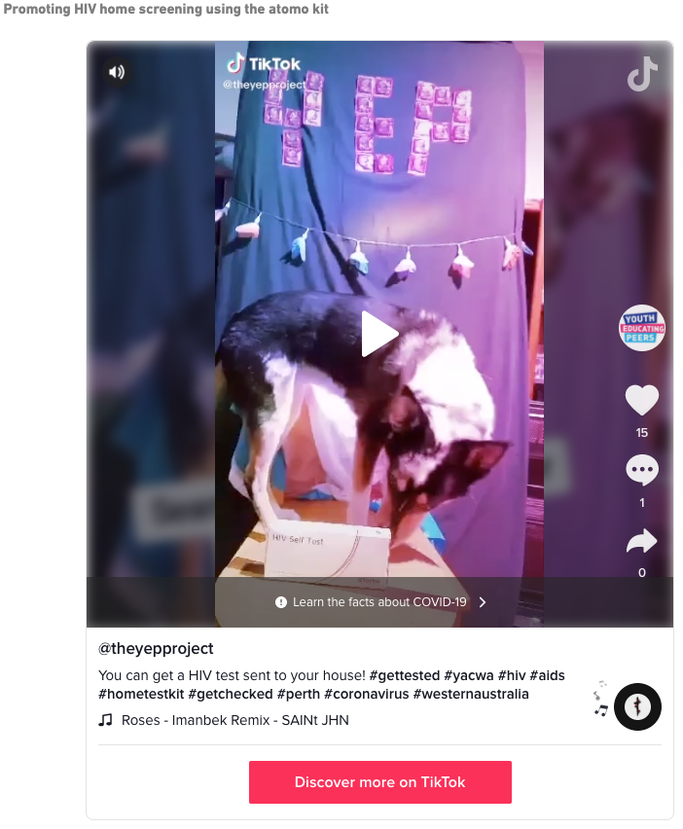
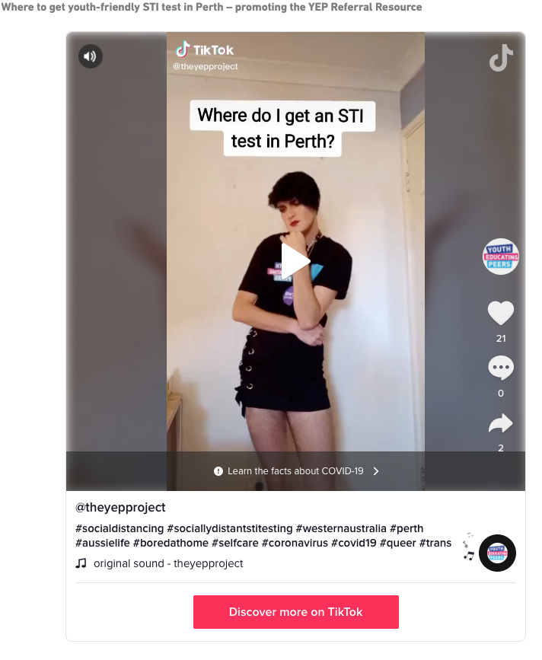
Educational Videos
theyepproject.org.au/blog/sociallydistantstitesting-campaign-resources
Notes:
Kai
24

Slide 25
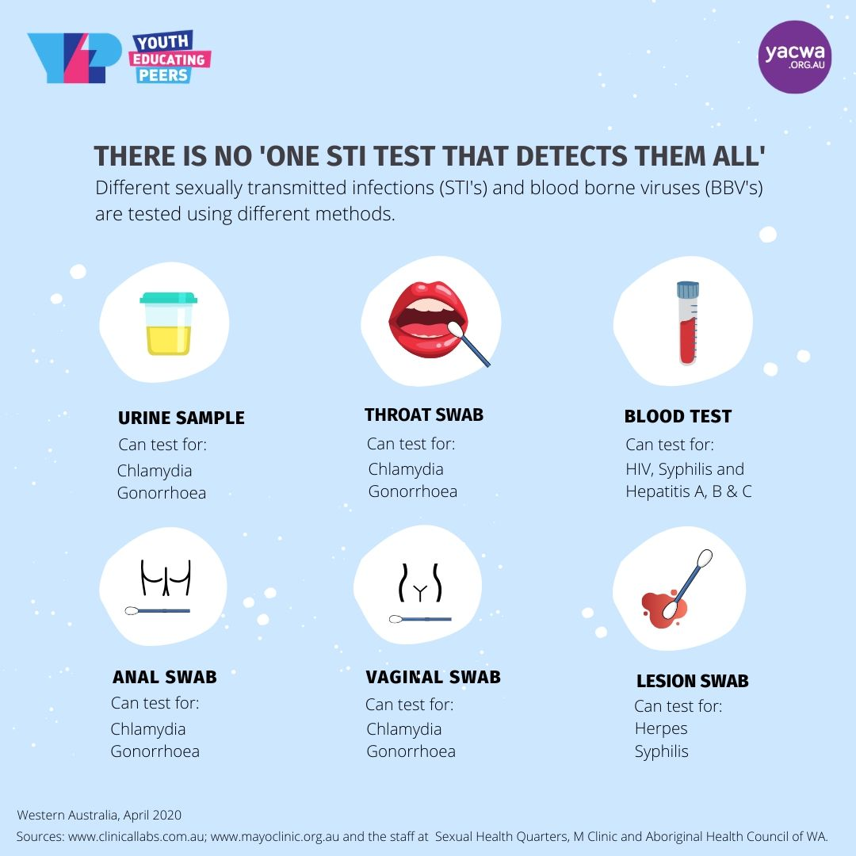
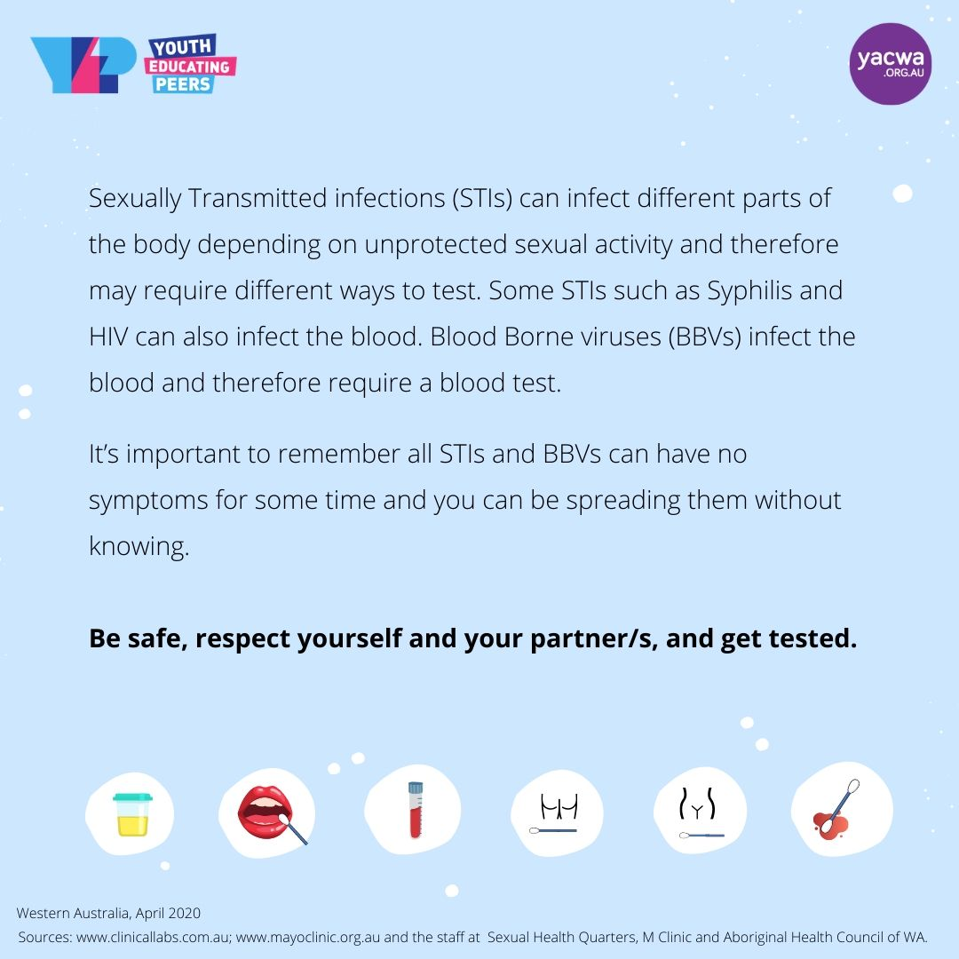
Infographics for Social Media
theyepproject.org.au/blog/there-is-no-one-sti-test/
Notes:
Kai
25

Slide 26
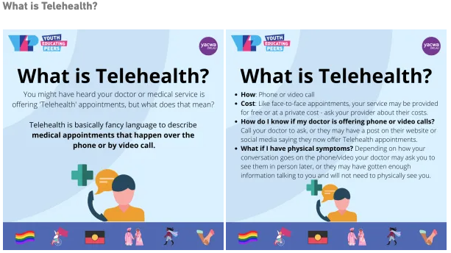
Infographics for Social Media
theyepproject.org.au/blog/sociallydistantstitesting-campaign-resources/
Notes:
Kai
26

Slide 27
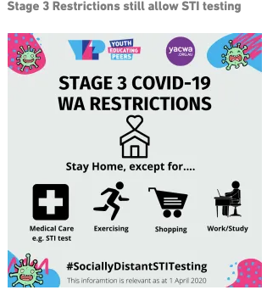
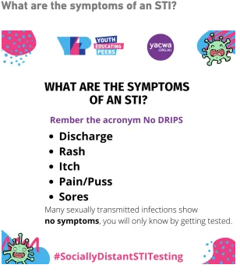
Infographics for Social Media
theyepproject.org.au/blog/sociallydistantstitesting-campaign-resources/
Notes:
Kai
27

Slide 28
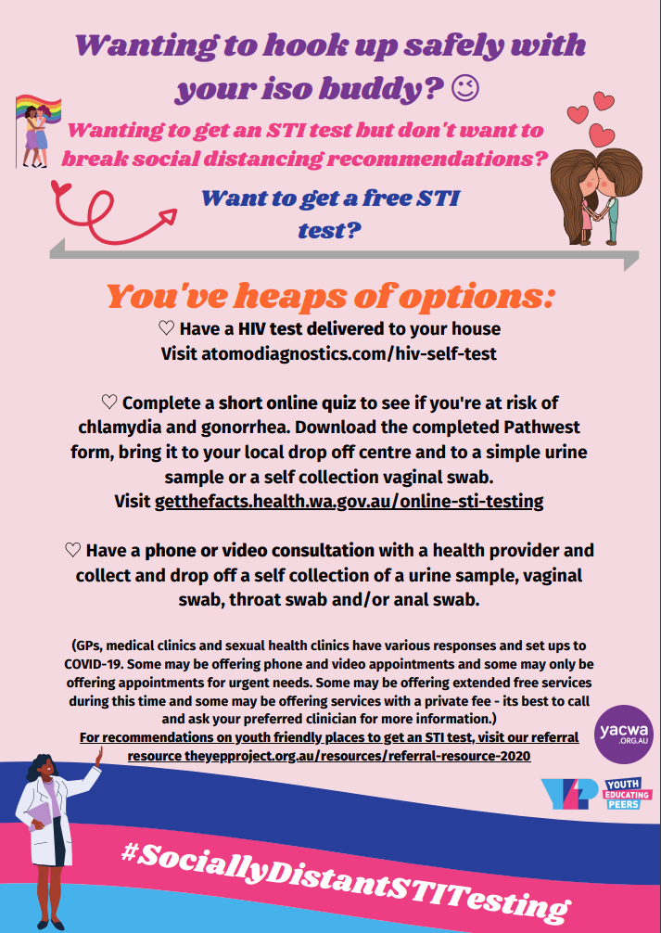
Poster Infographic
theyepproject.org.au/blog/sociallydistantstitesting-campaign-resources/
Notes:
Kai
28

Slide 29
Learnings from that first lockdown…
Provide responsive, accurate and engaging education material in a timely manner
Provide messaging across a number of channels through a variety of mediums
Seek input from young people and the youth sector about the topic choices and messaging (what they want and how they want it).
Continuously seek and review feedback from young people and implement it
Question why some resources or strategies were more successful than others and build on this
Promote and liaise with external agencies that can support the work and messaging
Utilize social media trends
Build momentum and regular engagement
Create material that is accessible for people with low literacy and those with a variety of disabilities
Promote messaging that is sex positive, validating and includes visible peers
Promote local self testing services, how to self collect and provide a peer perspective on what it was like to get tested this way.
Notes:
Kai
29

Slide 30
Key Outcomes
Notes:
Kai- intersex content

Slide 31
Key outcomes
from that first lockdown…
Increase in engagement with regional and remote young people and youth workers.
Increased engagement from SHBBV target populations via online platforms.
Significant increase in our social media following.
Increase in SHBBV knowledge of young people and the youth sector.
Increase in requests for professional development.
Increase in knowledge about our project.
Increase in development of culturally appropriate content.
Notes:
Kai
31

Slide 32
Asking people
what they wanted…
Notes:
Kai- intersex content

Slide 33
Asking people what they want
post lockdown…
Us: “Hey how was that experience for you? What did you think of our work?”
Them: “We loved what you did during COVID online, can you keep it up?”
Us: “Sure. What about the work prior to COVID?”
Them: “Oh we loved that too. Can you do both?”
Enter YEP, the hybrid model
Notes:
Kai
33

Slide 34
YEP Hybrid Model
Notes:
Kai- intersex content

Slide 35
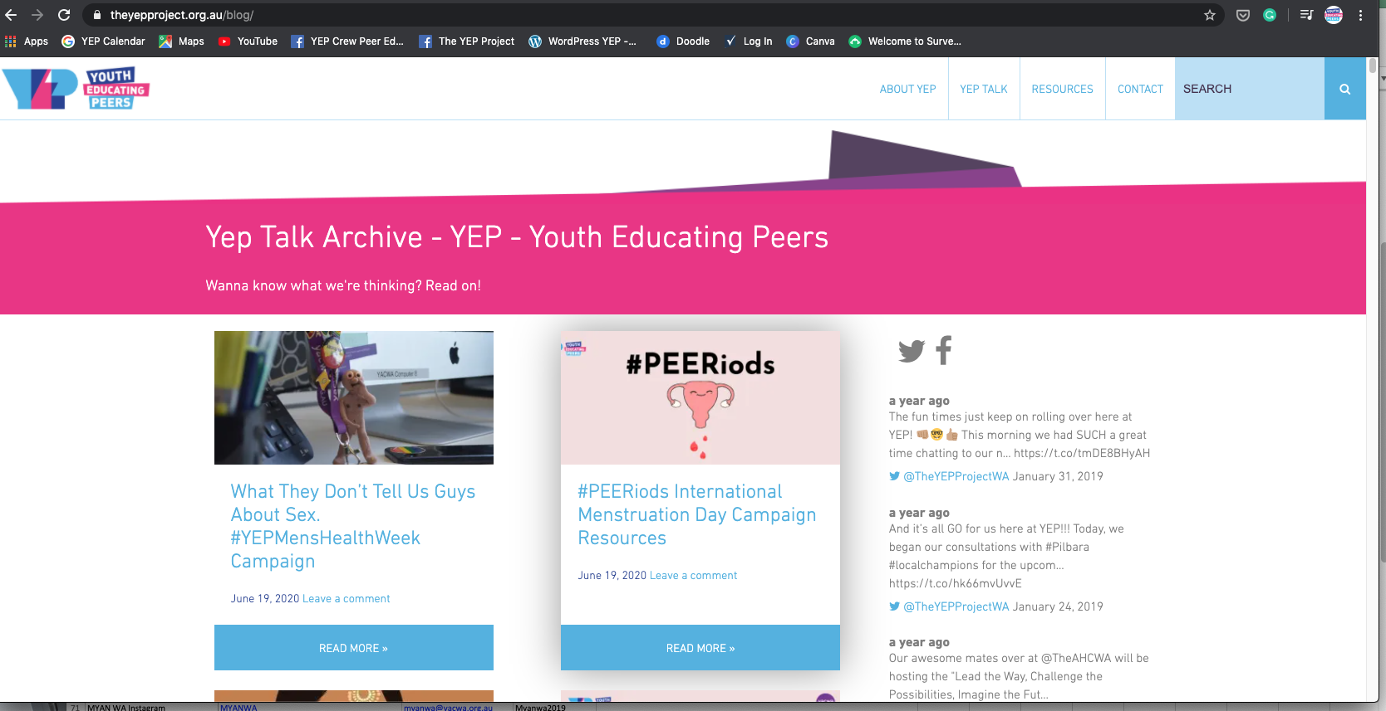
Maintain Online Engagement
Maintain your social media communication
Post regular and often, responding to social media trends and young peoples interests and concerns
Provide webinars for the youth sector on similar areas to support their clients
Create a recognizable brand
Notes:
Kai
35

Slide 36
Involve young people in the process
Use a peer-led approach.
Recruit paid peer educators to develop content.
Recruit a youth and sector reference group, ensuring representation from key SHBBV populations.
Recruit professional youth workers to support and guide the work
Partner with peer informed sexual health services to support the development of SHBBV content and promote their service.
Notes:
Kai
36

Slide 37
Create tools for
those supporting your audience
Provide webinars and professional development sessions that respond to topical youth sexual health needs.
Provide youth workers with resources and text that can be easily shared with clients via text message, email and/or on social media.
Provide access to resources on a website, social media and emailed to a wide network of professionals.
Ensure easy downloads, png, and pdf versions for re-sharing and high quality printing to enable resources to be mailed to clients or displayed in community.
Conduct regular youth and youth sector consultations and evaluations to maintain needs assessment.
Notes:
Kai
37

Slide 38
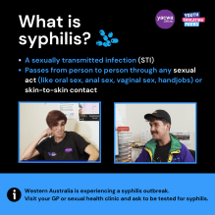
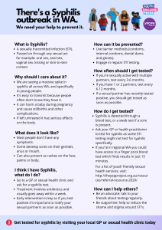
Recognise the needs of your audience
Use targeted messaging
We create content that caters broadly to all young people and also targeted messaging specifically for Aboriginal, culturally and linguistically diverse, LGBTIQA+ young people, young people with disabilities, youth at risk, and the youth sector.
Notes:
Kai
38

Slide 39
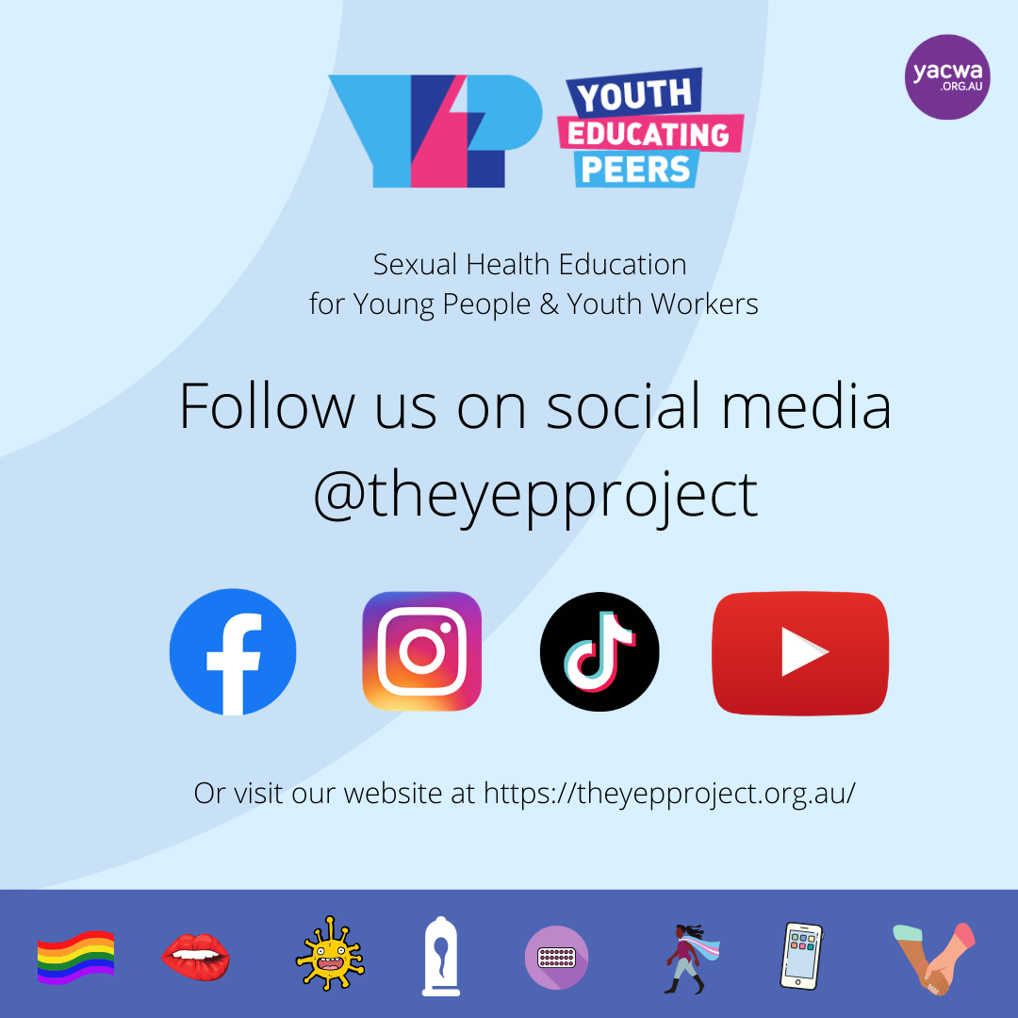
Recognise the needs of your audience
Use multiple platforms
We use TikTok, YouTube, Instagram, Facebook, and our website.
Notes:
Kai
39

Slide 40
Recognise the needs of your audience
Ensure accessibility
Hard caption videos.
Provide image descriptions.
Use high contrast colouring.
Use simple English.
Use images to convey messaging.
Utilise peers and in community language.
Create sensory aware lesson plans in physical workshops
Assess the learning styles and accessibility requirements of in person workshops and develop lesson plans accordingly
Utilize a trauma informed and inclusive approach in all sessions
Seek advice and evaluation from those with lived experience and professionals
Notes:
Kai
40

Slide 41
Recognise the needs of your audience
Use multiple mediums to convey your message
We use infographics, blogs, different length videos, and memes to cater for different learning styles and platforms, based on community feedback and trends.
Repeat messages across platforms.
Notes:
Kai
41

Slide 42
What next?
Continue that hybrid model
As measures eb and flow between lockdowns and easing of restrictions, continue to offer a hybrid model of in person delivery and online content.
Watch your engagement numbers, observe what’s working and what isn’t at regular intervals.
Seek feedback from young people and the youth sector about what kind of messaging they want and how and when they want it…
and don’t forget to have fun!
Notes:
Kai
42

