Slide 1

We are one but we are many:
Implementing and disseminating the I-SHARE study
in the context of a global pandemic.
Hanna Saltis, Jacqueline Hendriks, Sharyn Burns, Kristien Michielsen, Fiorella Fajedelatorre, Simukai Shamuts, Raquel Gomez, Johanna Shroeder, Gabrielle Perotta, Priya Kosana, Rocio Murad, & Joseph Tucker
SiREN Symposium, 2022
¹ Collaboration for Evidence, Research and Impact in Public Health, Curtin University.
A global university Western Australia | Dubai | Malaysia | Mauritius | Singapore
Notes:
The following research is part of the International Sexual Health and Reproductive Health or (I-SHARE Study), which investigated the impacts of COVID-19 restrictions on various aspects of sexual and reproductive health across more than 30+ countries. This presentation describes findings from the implementation survey and highlights the collective and unique challenges and opportunities of this global study.

Slide 2


Notes:
I pay my respect to the living, breathing and dynamic country that I live on, Boorloo, and the traditional custodians of this land, the Whadjuk Noongar elders past present and emerging from whom we can learn how to live in harmony and sustain and maintain our abundant environment. This land was stolen from the care of the custodians and sovereignty was never ceded.

Slide 3

Background

Slide 4
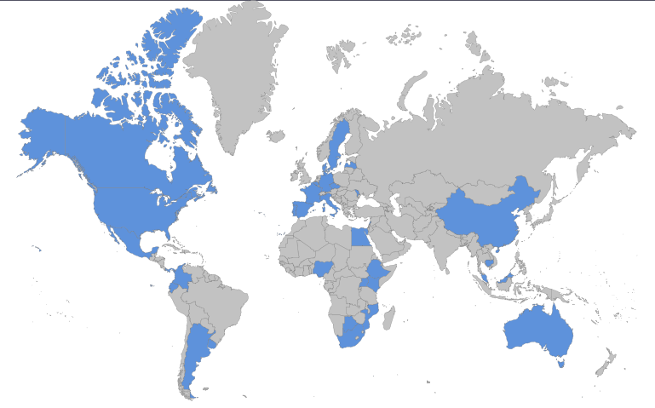
Background
    Hundreds of new studies/day
    Recruitment and implementation of studies in lockdown/socially distanced restrictions.
    Primarily online research.
    Demand for rapid and accurate data acquisition techniques.
    International Sexual Health And Reproductive Health (I-SHARE) Study: 30+ countries, 5 continents.
School of Economics and Finance
Notes:
The COVID-19 context provided a unique climate for research. Rapid research was needed to identify the needs of groups, develop appropriate/speedy public health responses and policy development in the rapidly changing environment. Read slides.

Slide 5
Methodology

Slide 6

Methodology
Aim
  To understand the recruitment and dissemination methodologies utilised by the countries within the I-SHARE consortium.
Objectives
  To collate the methods utilised by countries participating in the first wave of the I-SHARE study.
  To understand the challenges and successes countries faced, focusing on participant recruitment and survey implementation during the initial stages of the COVID-19 pandemic.
School of Economics and Finance
Notes:
This study is underpinned by the socioecological model of health, which situates individuals within their personal, interpersonal, environments and societal systems. This model helps us understand the complexities of our interactions and highlights the importance of our interactions with others and society at a broader level.

Slide 7
Methods
Call out for participating countries; countries collaborated to develop and pilot the instrument.
Individual IRB ethics approval was obtained by each country.
Each country recruited participants in their own country (min. n =200)
I-SHARE Consortium + several working parties developed research papers from the data.
School of Economics and Finance

Slide 8
Methods
Implementation research team meets monthly.
Survey data taken from the overall research (participation numbers etc.) and from an individual survey administered to in-country leads.
Data collection: ODK Briefcase and Google forms (deleted after download); stored securely on Curtin drive.
Analysis: Quant: (descriptive stats. analysed in SPSS and Excel); qual: content analysis (codes, categories and themes managed in NVivo).
School of Economics and Finance

Slide 9
Methodology: Socioecological Model
Five Levels of Influence
    Public policy
    Community factors
    Institutional factors
    Interpersonal processes and primary groups
    Intrapersonal factors
These factors are dynamic, interactive and reinforcing.
School of Economics and Finance
Notes:
This study is underpinned by the socioecological model of health, which situates individuals within their personal, interpersonal, environments and societal systems. This model helps us understand the complexities of our interactions and highlights the importance of our interactions with others and society at a broader level.

Slide 10
Results

Slide 11
Quantitative results

Slide 12
I-SHARE Participation
Country | N | Country | N
Argentina | 845 | Luxembourg | 568
Australia | 561 | Malaysia | 499
Botswana | 344 | Mexico | 1673
Canada | 163 | Moldova | 244
China | 827 | Mozambique | 66
Colombia | 2452 | Nigeria | 231
Czech | 1862 | Panama | 960
Denmark | 1001 | Portugal | 3323
Egypt | 31 | Singapore | 566
France | 1593 | South Africa | 29
Germany | 612 | Spain | 295
Italy | 329 | Sweden | 1307
Kenya | 243 | Uganda | 212
Latvia | 1176 | Uruguay | 696
Lebanon | 54 | USA | 305
Total |  | 23067
School of Economics and Finance
Notes:
This is an overview of each countries’ participation numbers (recruitment). Countries needed a minimum of 200 survey responses to participate. Only completed survey responses were collected.

Slide 13
Quantitative Results
School of Economics and Finance
Notes:
Describe slide

Slide 14
Quantitative Results
*n = 30
**n = 27
Notes:
Describe slide

Slide 15
Qualitative results

Slide 16

A crash course in adaptation and flexibility.
“We tried to use different approaches (e.g., social media, university contacts, press releases to media, partnership with organizations in the field of SRH, etc.) and this had finally worked after a lot of investment and time”. ~ Portugal (n = 3323)
School of Economics and Finance
Notes:
All countries demonstrated the ability to quickly adapt to the changing and isolating climate. Predominantly, this meant changing to online platforms. A few countries used novel recruitment techniques that ensured representative samples. However, this was at a cost, and those who lacked funding but had large numbers used a variety of recruitment methods. Talk a little about Portugal and Latvia.

Slide 17

Better together: Collaboration and Partnerships.
“We involved young scientists - students and an Ob/Gyn resident - it helped a lot for using social media, promoting the I-SHARE among young people and later during the qualitative research part.” Latvia (n = 1176)
School of Economics and Finance
Notes:
The majority of in-country leads mentioned the value of collaborations. These were existing, such as in Panama, who were able to rely on their personal networks to share after facing some backlash from other institutions. Collaborations within the I-SHARE consortium were invaluable and many mentioned the benefits of discussions about challenges with recruitment and implementation at this time. Importantly, having a cohesive and diverse research team was essential, and Latvia highlights this nicely, here.

Slide 18

Same but different: Homogeneity and heterogeneity of countries.
“By the time we sent the survey out the population had fatigue for COVID surveys, and the lockdown levels had changed a couple of times”. ~ South Africa (n = 29)
“Recruitment may be easier when we are in a specific lockdown.” ~ Australia (n = 531)
“COVID-19 was a big challenge and the economic and humanitarian crisis in the country made it impossible for people to get attracted to the survey.” ~ Lebanon (n = 54)
School of Economics and Finance
Notes:
This concept highlights the ongoing tension between creating a standardised tool for a diverse range of countries to use while capturing and honouring each country’s unique context e.g., COVID levels, lockdown restriction severity. In Australia, we really struggled to gain numbers, and we hypothesised similar to South Africa this may have been due to the relevance of the pandemic – everything was almost normal in some places – or due to survey fatigue. These examples from two countries that struggled to gain numbers indicate that survey completion may be a low priority in comparison to navigating financial and other socio-ecological factors that would become more salient to individuals in a pandemic.

Slide 19

All things are not equal in a pandemic.
“The recruitment of populations aged 35 + - this population is less prone to use technology for give [sic] personal information through this channels [sic]” ~ Colombia (n = 2452)
“Respondents said our questionnaire was too long for poor people to commit data to answer the questionnaire.” ~ Nigeria (n = 231)
“We had problems with…one of the surveys, because of the language and lost part of the information of one group of participants.” ~ Luxembourg (n = 568)
School of Economics and Finance
Notes:
Connected to the last theme, these inequities highlight a deeper systemic issue where those voices most vulnerable, and likely in need of the most aid during a pandemic do not have the resources to contribute to the study. These inequities are also evident within research teams and at the institutional level. As Luxembourg highlights, there were different demands on different countries at each stage. Funding was also luck of the draw in that there was no central funding for the project. Some got small grants, others were given larger sums (either by govt. or their institutions) and others, like Aus. got nothing at all and had to rely on surplus or volunteer work). This meant that the study was given varying levels of attention – country dependent.

Slide 20

Limitations
  Low capacity to do more interpretive statistics
  Reliance on participation numbers to determine “success”.
  Self-reporting bias
  Not all countries represented – countries who participated had capacity.
School of Economics and Finance

Slide 21
Recommendations
Collaborate, collaborate, collaborate
  Develop an “emergency situation” research protocol.
  Ensure surveys are relevant to individual contexts.
  Diversify your team (students, volunteers etc.)
Show your appreciation for your hardworking team (not just in pandemic conditions)!
School of Economics and Finance

Slide 22
Acknowledgements
Thanks to the I-SHARE team for assistance. Other members of the I-SHARE team are listed here https://ishare.web.unc.edu/team-members/.

Slide 23
Contact us
Hanna Saltis
08 9266 3968
hanna.saltis@curtin.edu.au
Twitter
@I-SHARE_Survey
@CERIPH_HP

Slide 24
Thank you
Make tomorrow better.

