Slide 1
Social Determinants of Disease: HIV and COVID‐19 Experiences
Raiza Beltran, PhD MPH
T32 Global HIV Prevention Research Postdoctoral Fellow
Department of Infectious Diseases, UCLA DSGOM
(on behalf of my co-authors: I.W. Holloway; C. Hong; A.M. Ochoa; L. Cordero; E. S.C. Wu; K. Burris; P.M. Frew)
Notes:
Presenting on behalf of my co-authors

Slide 2
Disclosures
I have no conflict of interest
The information presented here does not represent the official views of the institutes that fund our work

Slide 3
Notes:
A quick background of our paper, it was published in February of this year as a part of a special issue of Current HIV/AIDS Reports, the purpose of this paper was to examine how structural racism have left certain racial groups vulnerable to both COVID 19 and HIV

Slide 4
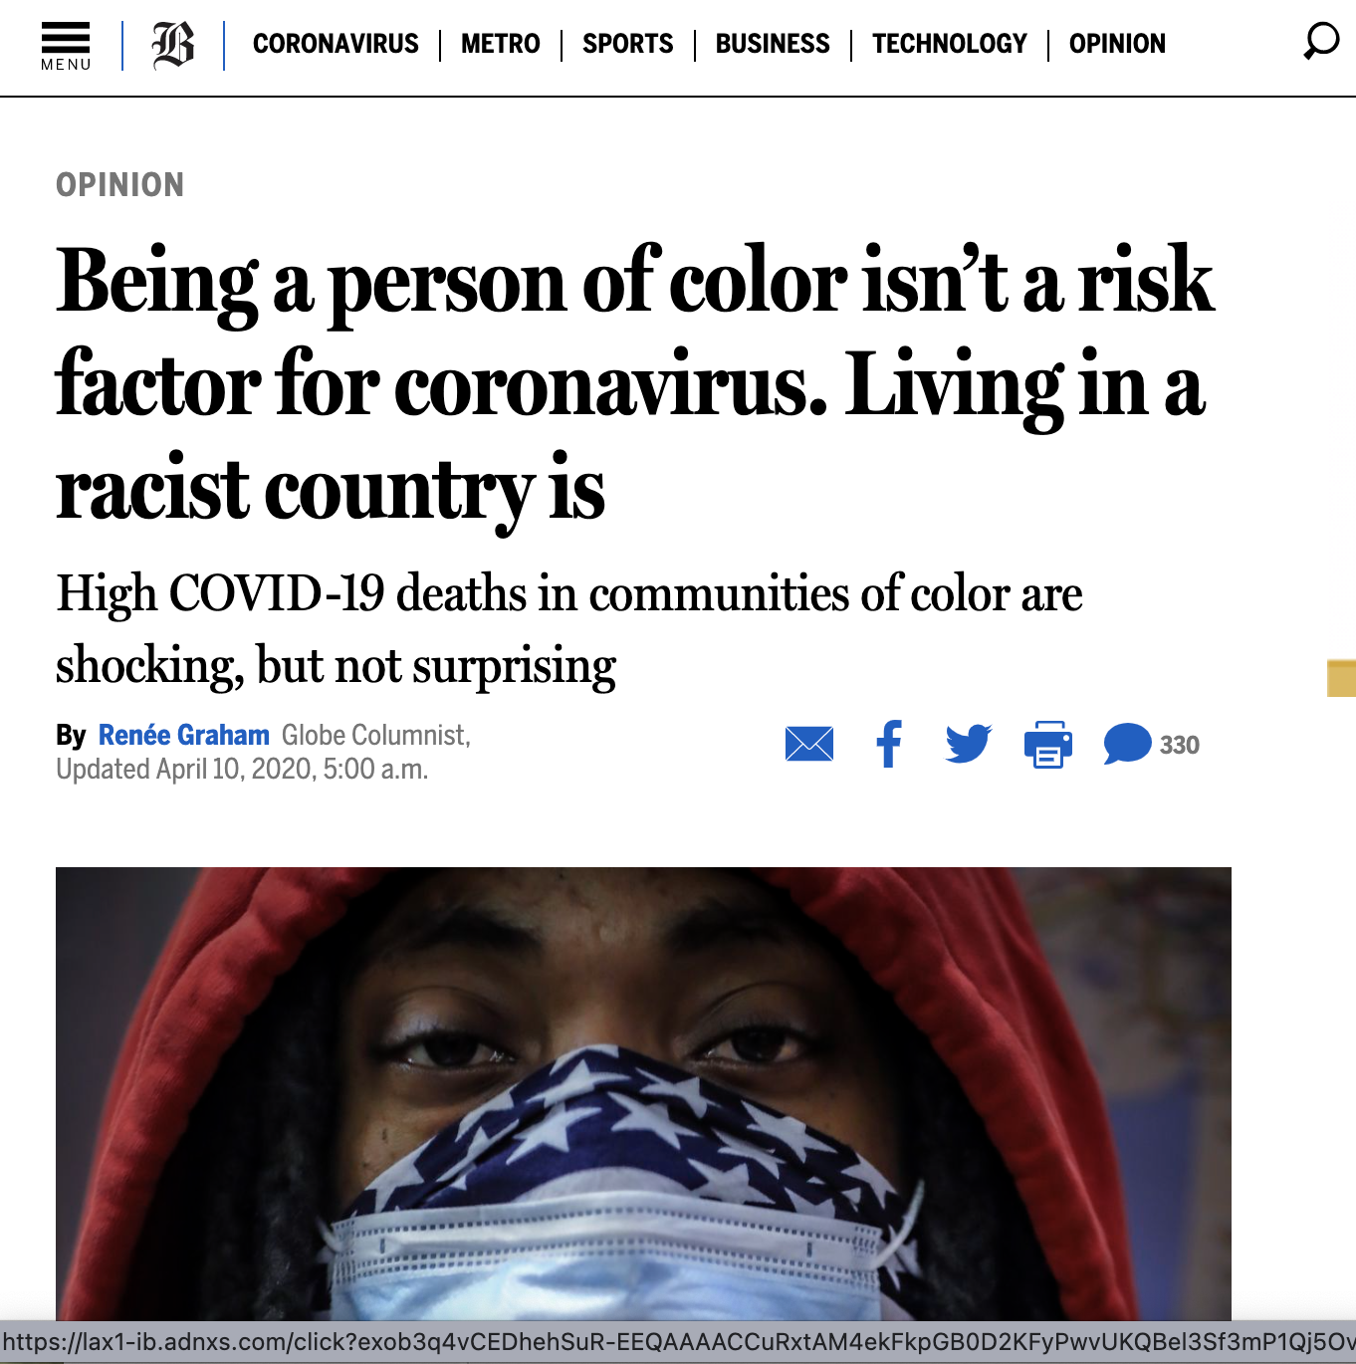
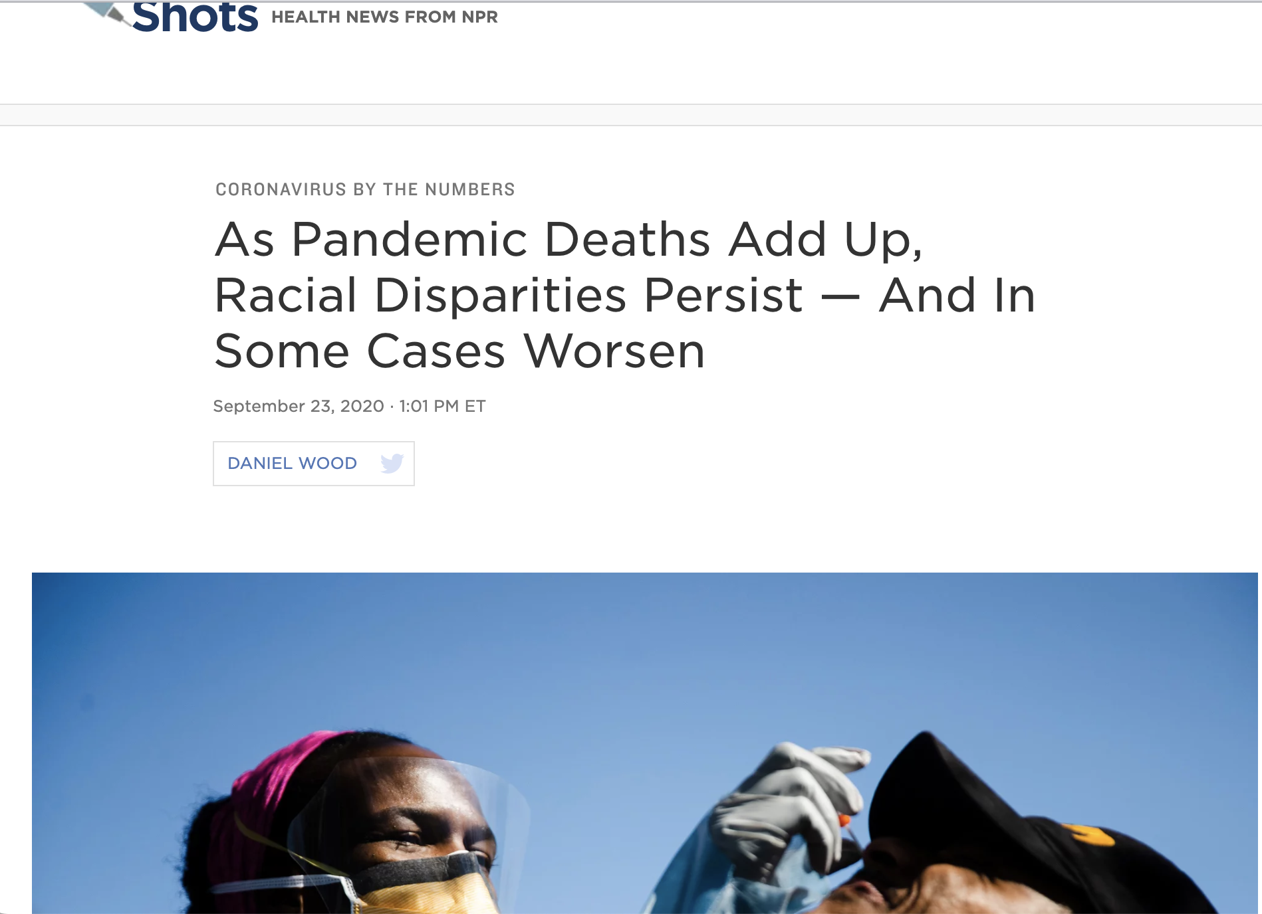
Background/Introduction
Notes:
As we all know, COVID-19 had a disproportionate impact on racial and ethinic minority communities in the U.S. as well other countries. It was certainly in the news here and across the globe.

Slide 5
Search Strategy
Coronavirus
N=297
HIV/AIDS
Health Equity
Race/Ethnicity
N=210
N=125
Literature Search: 2020-2021 (COVID-19); 2010-2021 (HIV)
Notes:
For the search strategy of this article review, we used PRISMA guidelines to conduct a literature search in PubMed using combination of key words, phrases, and Medical Subject Headings:
Our Literature Search was conducted between Fall of 2020 to Spring of 2021 for COVID-19 related articles; We also extended our search from the last decade for HIV-specific literature.
We initially found 297 articles, after duplicates were removed and screening of titles and abstracts, we had a total of 210 independent articles that we reviewed fully for eligibility, and finally 125 articles were included in this review.
Because we reviewed quite a bit of literature, I will give you some relevant examples of the studies we found

Slide 6
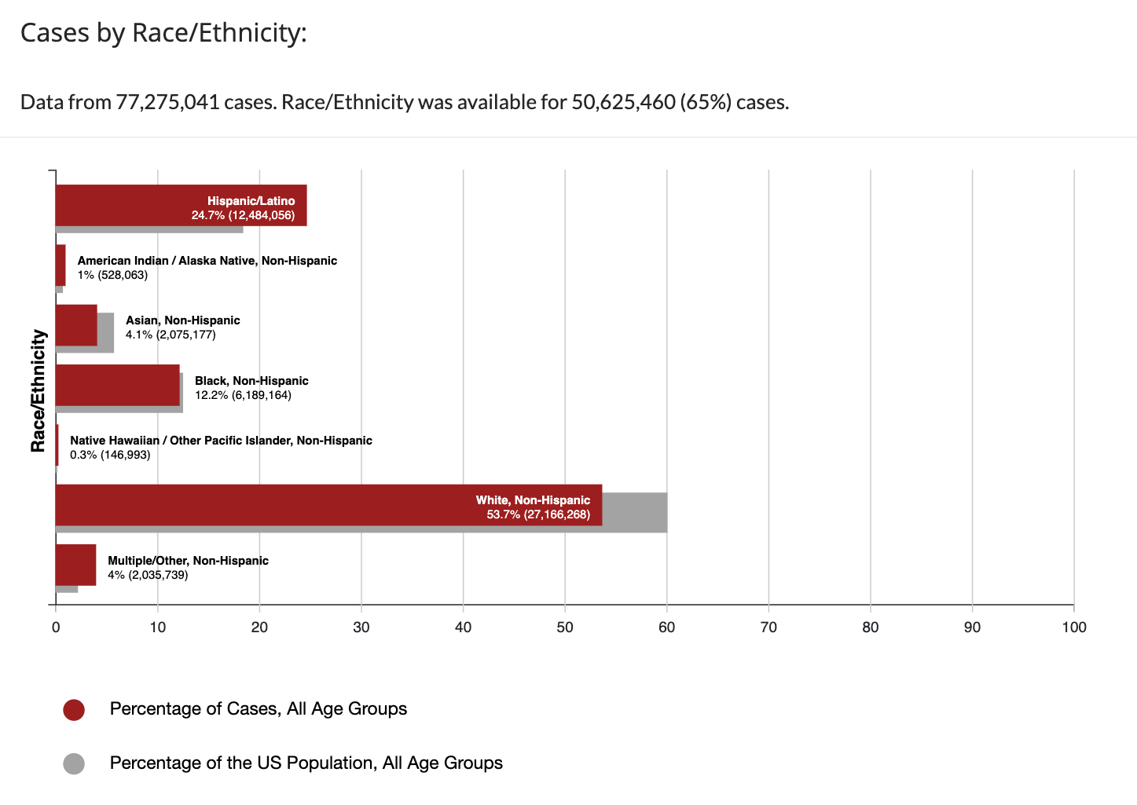
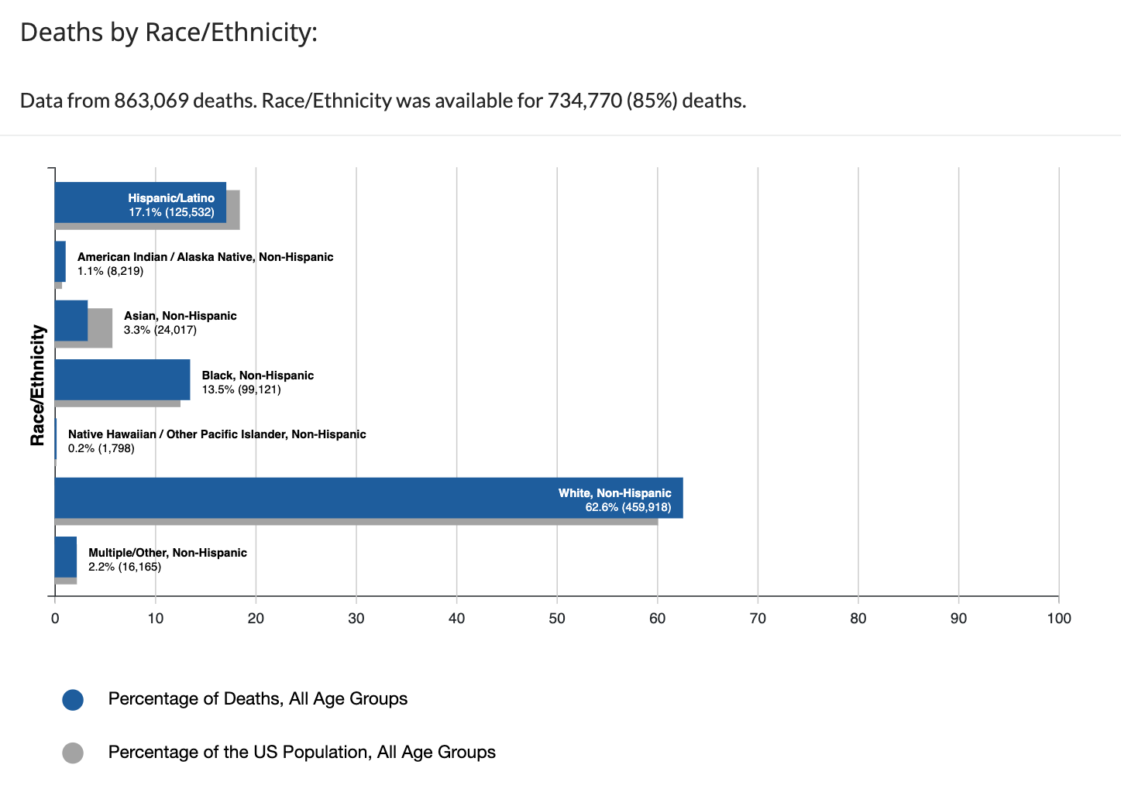
Examining Race: COvID-19 & HIV
“Racism is a fundamental cause of health inequality” - Link and Phalen
COVID-19
CDC, 2022
Notes:
To better understand the disparities in infection, hospitalization and death rates related to COVID-19 and HIV, we decided to look at the root of the issue which is how these diseases intersect race.
Medical Sociologists: Link and Phalen established that (independent of socioeconomic status)
Research findings on COVID-19 and HIV, substantiate Phelan and Link’s assertion –
While Black, Latinx and Native Hawian and Alaskan Native communities make up a smaller percentage of the U.S. population, they were shown to have higher rates of COVID-19 infection and deaths

Slide 7
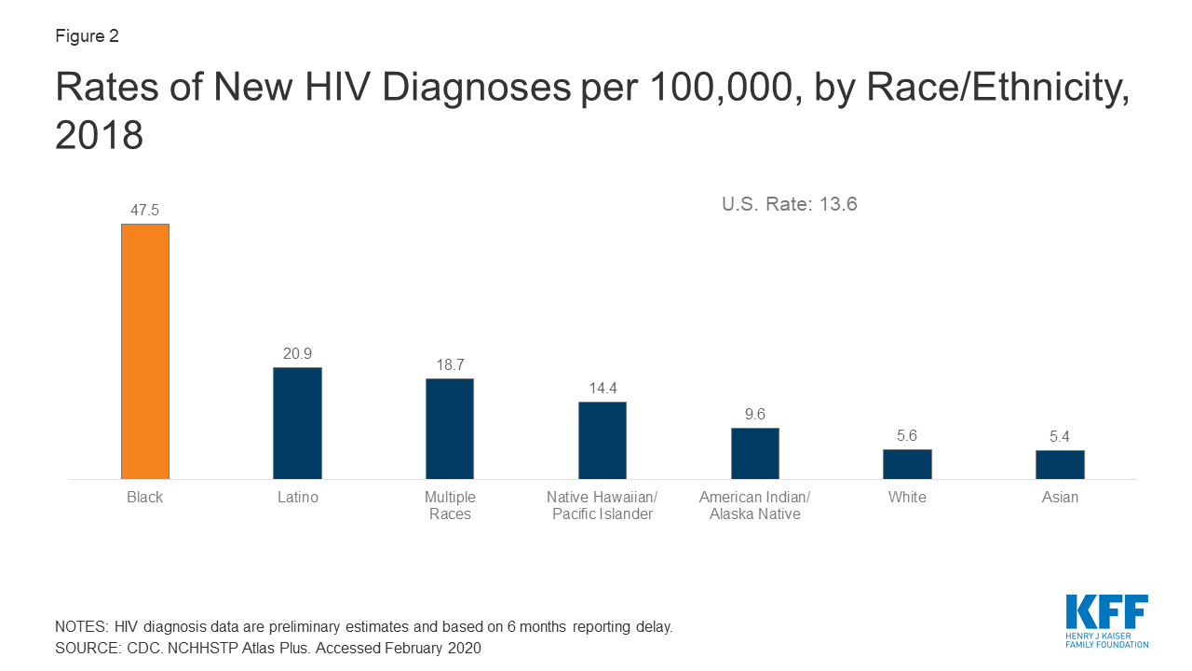
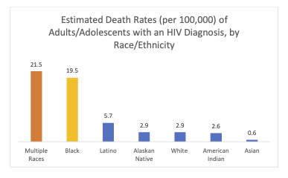
Examining Race: COvID-19 & HIV
“Racism is a fundamental cause of health inequality” - Link and Phalen
HIV
Kaiser Family Foundation, 2018; 2019
Notes:
Medical Sociologists: Link and Phalen (independent of socioeconomic status
For HIV new diagnoses and related deaths: Black, Latinx and those identifying as having multiple races were shown to be significantly impacted by HIV, predominantely affecting men who have sex with men and cisgender heterosexual women

Slide 8
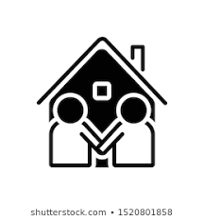
SOCIAL Determinants of Health
Economic Stability
Social & Community Support
Neighborhood & Built Environment
Healthcare Access & Quality
Education Access & Quality
Notes:
What we know is that Infectious disease transmission doesn’t occur in a vacuum…! Societal Factors and institutions help produce vulnerability to both HIV and COVID 19 for racial and ethnic communities in the U.S.
So we looked at a host of social determinants, as identified by the CDC:
Among of these are:
Economic Stability like Jobs and financial security
Neighborhood and Built Environment – parks where families and kids can walk, livable homes
Education access and quality – an example of this would be having good teachers, well-funded schools that are affordable for all families
Healthcare access and quality – such as having shorter wait time to see a healthcare provider, low cost prescription medication, easy access to clinics
Social and community support – availability of mutual aid associations, churches and community organizations that provide support, and close family and friends
To make sure we are keeping with the time allotted, I will only highlight the studies we reviewed for each of these social determinant

Slide 9
SOCIAL Determinants of Health: Economic Stability
Economic Stability
Notes:
So in our paper - we looked at each one of these determinants and examined how race might intersect with the disparities in COVID-19 and HIV:
In terms of Economic Stability:
Among industrial nations, the U.S. ranks high in income inequality with most of the country’s wealth attained by only 1% of the total population

Slide 10
Economic Stability
COVID-19
N=1800 found nearly 8x higher risk of infection among low-income Black vs. White patients¹
67% higher death rate for U.S. counties with lowest economic privilege²
Mass unemployment during the pandemic led to reduced health care benefits³
Essential (grocery store, sanitation, restaurant) workers, largely Black & Latinx, had higher risk for infection⁴
HIV
Residents in higher poverty U.S. counties had higher dx rates⁵ particularly for Black women⁶
High poverty areas have limited opportunities for employment, healthcare access and education⁷
Low-income people living with HIV (PLWH) have low linkages to care, unsuppressed viral load and lower quality of life^{8, 9}
Notes:
This is evident in the studies we found - economic stability has an impact for both COVID-19 and HIV:
for Example:
In a study of 1800 individuals, low-income Black patients had 8x higher risk for COVID-19 compared to low-income white patients
U.S. counties with the lowest economic privilege had a 67% higher COVID-19 mortality rate, compared to counties with higher economic privilege
Also, as we know, there was mass unemployment during COVID-19, which led to employees living without healthcare benefits, reducing their ability to seek care
Finally those who continued to work in lower-paying jobs (such as grocery store, sanitation and restaurant workers), were at higher risk for COVID-19 infection.
We Found economic stability to impact HIV transmission and HIV care engagement as well:
One study found that residents living in higher poverty U.S. counties had higher HIV diagnoses rates, this was especially true for low-income Black women.
one study pointed to low-income areas having limited opportunities for employment, access to healthcare and education as potential causes for increased HIV diagnoses rates
For those living with HIV, having lower income was associated with less engagement with HIV care, an unsuppressed viral load and having a lower quality of life.
Khanna et al, 2021; Dalsania et al., 2021; Snowden et. al, 2021; Bui et al., 2020; Gatntz 2012; Reif 2017;

Slide 11
SOCIAL Determinants of Health: Neighborhood and the Built Environment
Neighborhood & Built Environment
Notes:
We now look at the neighborhood and
Built environment

Slide 12
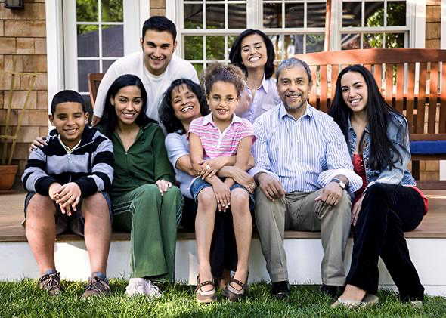
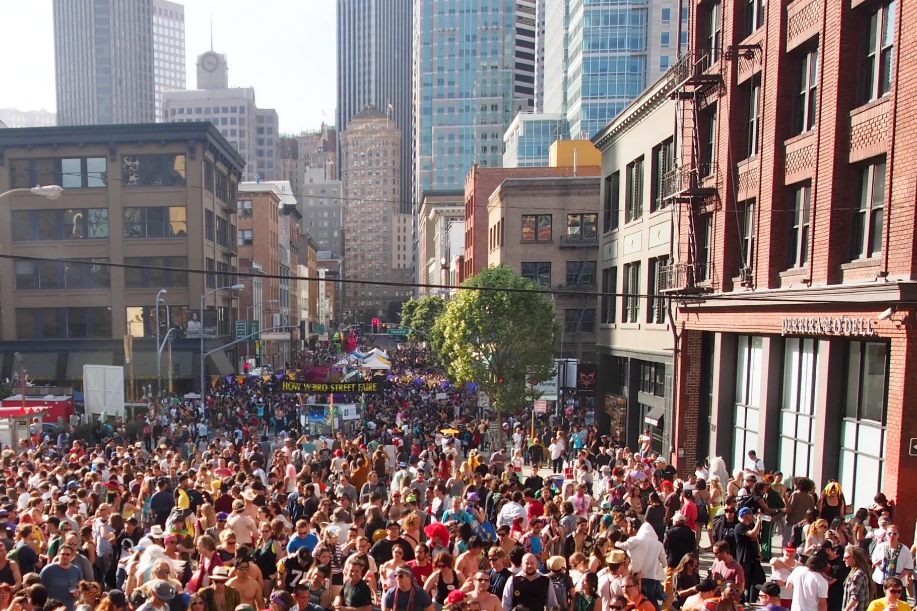
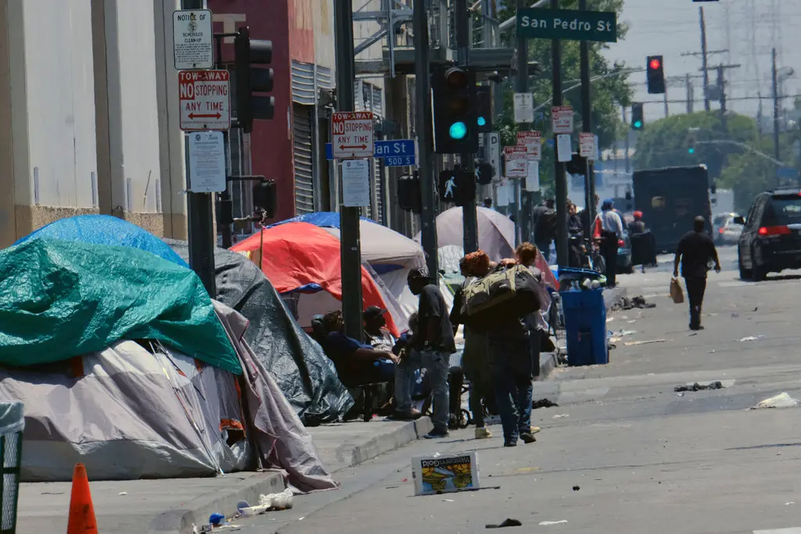
Neighborhood & built Environment
High household density:
increased COVID-19 transmission risk¹⁰
Densely populated cities: Black & Latinx residents more likely to get COVID-19 dx¹¹
Lack of stable housing led to higher hospital admittance for COVID-19¹²
Demographic density: MSM living in areas with high pop. of LGBT/SGM have lower HIV diagnoses¹³
Housing instability leads to lower HIV care engagement and higher risk for HIV¹⁴
Housing Density – not linked to HIV risk
Notes:
What we found was that:
High household density which is defined as: residences with more than one person in a room, multi-generational households, or overcrowded homes increased COVID-19 transmission risk;
Densly populated cities also increase covid-19 risk: particularly for Black and Latinx residents
Finally, those without stable housing had higher hospital admittance rates for COVID-19 (likely due to lower hygiene facilities, living in congregate settings)
in terms of HIV:
Housing density has not been to found to be linked to HIV risk
MSM living in areas with a higher percentage of lesbian, gay, bisexual and transgender (LGBT) residents were found to have a lower HIV diagnosis rate compared to MSM living in less LGBT-populous communities, suggesting that living in more LGBT-friendly communities can be protective against HIV.
Housing instability is linked to reduced HIV care engagement among people living with HIV and increased HIV risk

Slide 13
SOCIAL Determinants of Health
Social & Community Support
Notes:
Now we turn to: Social and community support – mutual aid associations, churches and community organizations, family and friends
- we rely on for intrinsic support, monetary support, emotional support

Slide 14
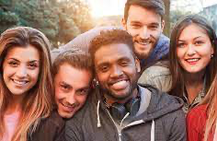
Social and community support
Both COVID-19 and HIV initially seen as a “foreign virus” in the U.S.
Leads to stigmatization and discrimination:
Anxiety, depressive symptoms and sleep disorders rose 40% and experienced discrimination up 30% among Asian Americans; buffered by social support within the community¹⁵
HIV-related stigma found to be higher in the Black community than other racial groups;¹⁶ that impact HIV prevention efforts;¹⁷ instrumental support from family members help reduce stigmatization¹⁸
Anti-discrimination laws may reduce risk for infectious disease transmission and mortality rates; particularly with HIV risk among MSM¹⁹
Notes:
In our review what we found was that:
social and community support may not come easy for those at risk or living with COVID-19 and HIV
In the past infectious diseases have been viewed as “foreign” - brought to the US by non-citizens who are believed to be “different” from the general population (HIV was first believed to be brought by Hatian immigrants and COVID-19 was deemed a “Chinese Virus”
COVID-19 and HIV brought fear to the general public
Which can lead to stigmatization and discrimination:
At the start of the COVID-19 pandemic, Asian Americans’ anxiety, depressive symptoms, and sleep difficulties rose 40% and experienced discrimination increased 30%. However, social support help buffer the negative effects of discrimination in this population
In regards to HIV: the Black community experience higher HIV-related stigma compared to other racial groups, which can impact HIV prevention efforts. However, family support help reduce stigmatization
What we know is that anti-discrimination laws can alleviate these negative experiences, and even reduce the risk for HIV (which was found among MSM in one study)

Slide 15
SOCIAL Determinants of Health
Healthcare Access & Quality
Notes:
We'll move on to healthcare access and quality

Slide 16
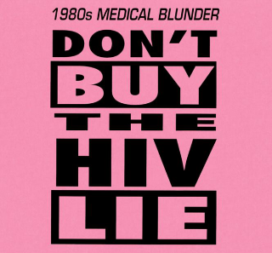
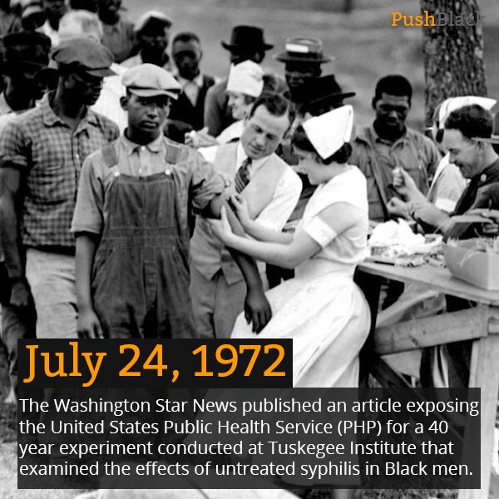
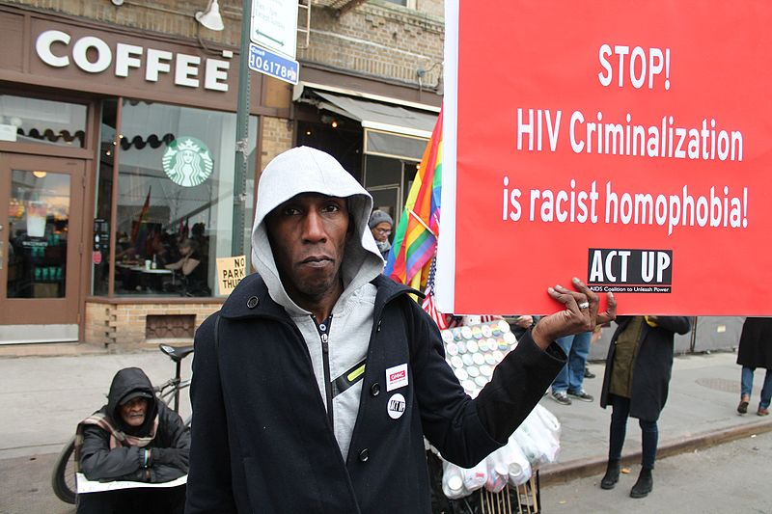
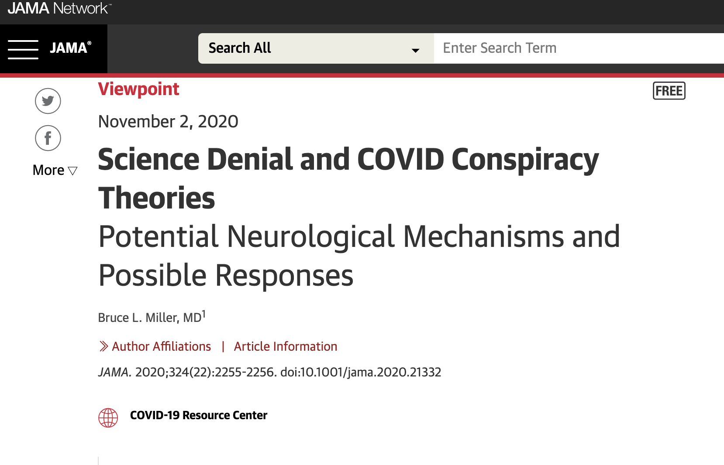
HealthCare Access & Quality
Credit: Elvert Barnes Protest Photography
Notes:
Long before COVID-19 became a global pandemic, communities of color have held a deep distrust in the medical and healthcare system due to the history of discrimination, harm and abuse they experienced in the hands of their providers (an example of this is the Tuskeegee study in which 399 Black farmers living in the U.S. south in the 1930s and 40s were studied to understand syphillis, but were denied life-saving treatment). This deep distrust remain in the community and continues to weakened the ability of the public health system to communicate appropriate and relevant information regarding both COVID-19 and HIV, particularly within the Black community. We reviewed studies that demonstrate medical mistrust has led to lower testing and later stage presentation of COVID-19 in hospitals. And for people of color living with HIV, they found to have lower linkages to HIV care after a diagnosis due to medical mistrust, compared to their white peers.

Slide 17
SOCIAL Determinants of Health
Education Access & Quality
Notes:
Finally we will end with the last social determinant of health - Education access and quality

Slide 18
Education Access and Quality
COVID-19
Areas with lower number of high school graduates was associated with increased COVID-19 related deaths²⁰
HIV
PLWH without a high school degree were shown to have lower HIV care engagement and viral suppression²¹
Notes:
We found only a very small number of studies that showed educational level or educational achievement independently impacting COVID 19 or HIV – most of the studies included education level etiher as a covariant or a variable to control for in their analyses. However some of the studies that we highlight in our review include:
One study that showed:
For HIV

Slide 19
Conclusion
Structural and systematic factors drive HIV and COVID-19 related inequities, particularly among communities of color
Stigma and discrimination excacerbate these inequities, but can be mitigated by social and community supports and engagement
This review highlight the importance of investing not only on biomedical technological advances to eradicate COVID-19 and HIV, but in a more just public health infrastructure and social safety net that would meet the needs of marginalized communities.
Notes:
Overall through this review

Slide 20
Acknowledgements
Funding Acknowledgement: Dr. Beltran is supported by the National Institutes of Health under award number T32MH080634. Dr. Holloway acknowledges support from the National Institute of Mental Health (P30 MH58107) and the California HIV/AIDS Research Program (RP15-LA-007).
Stay connected with us on our social media!
@uclahhipp

Slide 21
References

