Slide 1
An inclusive space providing sexual health and blood-borne virus information for the trans, gender diverse & non-binary community
Notes:
The transgender, gender diverse and non-binary people who took the time to share their thoughts and experiences via consultation, and took part in our photoshoot.
Stevie Lane (@thequeeradvocate), a digital creator who created video content for the website and shared information about the project through their networks.
Hanna and Sam for their involvement in the video consult.
Tegan Stoney (@stoneysdraws) who created beautiful illustrations for the project.
Marziya Mohammedali (@kikeidotnet) who took the wonderful photographs used on the website.
Our steering committee stakeholders from TransFolk of WA, Freedom Centre, Mental Health Commission of WA, WAAC and the Western Australian Department of Health for their ongoing support and valuable input.
The YEP Project, RUAH, HepatitisWA and SECCA, who provided initial input to the project.
ACON Transhub, who provided ideas for consumer engagement and offered helpful resources.
Royal Perth Hospital and WA Primary Health Alliance for helping to distribute surveys.
Studio KFord for developing a logo for EmbraceU.
The team at Humaan for creating the EmbraceU website.

Slide 2
Purpose of EmbraceU
The aims of the project:
1
2
3
increase knowledge and perceptions of risk around sexually transmissible infections (STIs) and blood-borne viruses (BBV's)
identify and reduce barriers to accessing services
increase testing pathways

Slide 3
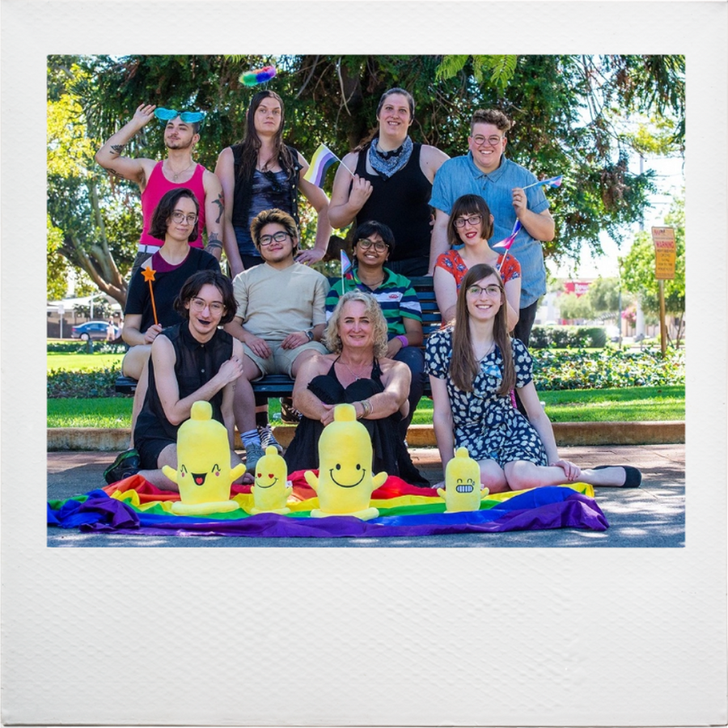
Community Collaboration

Slide 4
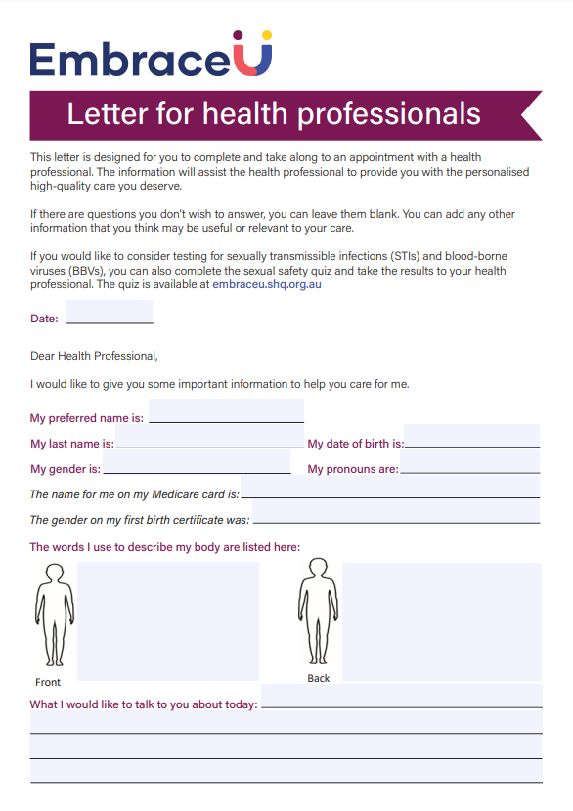
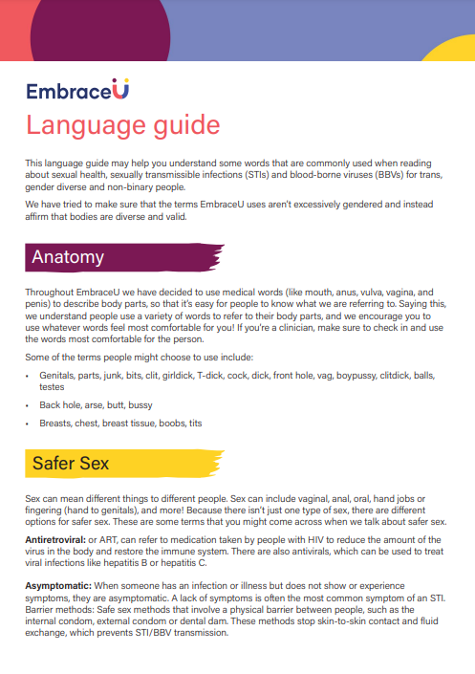
Letter for professionals
Language Guide
Testing Information
for health professionals

Slide 5
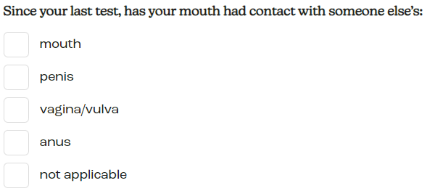
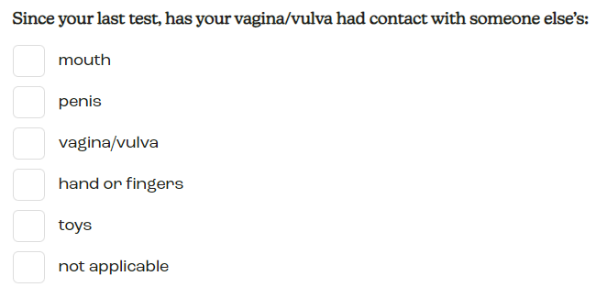
Sexual Safety Quiz
The sexual safety quiz is designed for an individual to understand how often they may need to have STI/BBV testing. The quiz asks questions without the use of gendered terms.
#
The quiz also asks about BBV risk behaviour, e.g. sharing injecting equipment, disclosure from partners, vaccination, symptoms, and use of barrier methods/condoms
Quiz results can be emailed to individual on request, and are not stored on the website
B

Slide 6
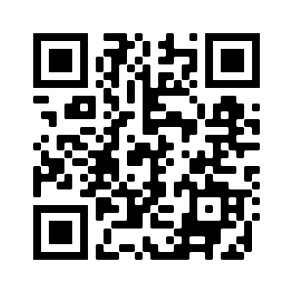
Sexual Health Testing Video

Slide 7
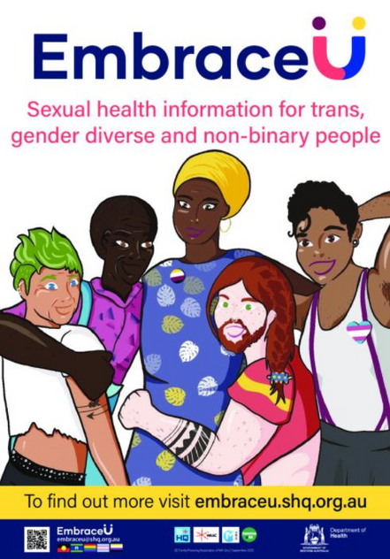
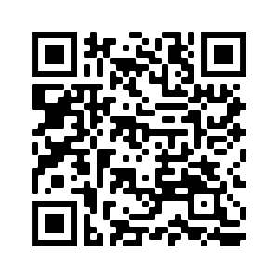
Print Resources
EmbraceU includes a brochure, wallet cards, and posters which can be downloaded online, or ordered through the website.
The brochure includes information on safer sex and STI/BBV testing info targeted at people who are trans, gender diverse and non-binary. It also discusses your rights as a patient, and directs readers to the EmbraceU website for more.
If you would like to order these resources, this QR code will take you to the ordering page!

Slide 8
Evaluation
“The cameos with quotes make it personal and foster a sense of familiarity and community. Inclusive of nonbinary identities and POC, which is very important.”
"I would love EmbraceU to be WA's TGDNB sexual health site, so literally any expansion on/sequels to any of the topics/resources would be lovely to see!"
"Thank you so much for letting me take part in this, I'm really new to transitioning so it's really validating might sound silly but very happy to have been here"
"I hope you can have even more trans resources - I know sexual health is the focus here, but I think having an expansive list really would help some folks out in a confidential space and might help convince people to look after their sexual health if they have more validating resources!"
“I like the big, bright colours, they make me feel safe and affirmed.”

Slide 9
Thank you!
www.embraceu.shq.org.au/
embraceu@shq.org.au

